Slide 1


Exploring Wisconsin’s
Weather & Climate
Edward J. Hopkins, PhD
Assistant Wisconsin State Climatologist
Dept. of Atmospheric & Oceanic Sciences
University of Wisconsin-Madison
12 June 2016
Oregon Area Historical Society–
Oregon, WI
Notes:
Melanie Woodworth
Oregon Senior Center Bldg
http://www.ssec.wisc.edu/data/globe/cldspin.html

Slide 2
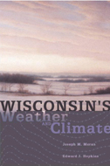
Wisconsin's Weather & Climate
by Joseph M. Moran &
Edward J. Hopkins
from
UW Press
Notes:
http://www.wisc.edu/wisconsinpress/books/3082.htm

Slide 3
http://www.wisc.edu/wisconsinpress/books/3082.htm
Notes:
http://www.wisc.edu/wisconsinpress/books/3082.htm

Slide 4
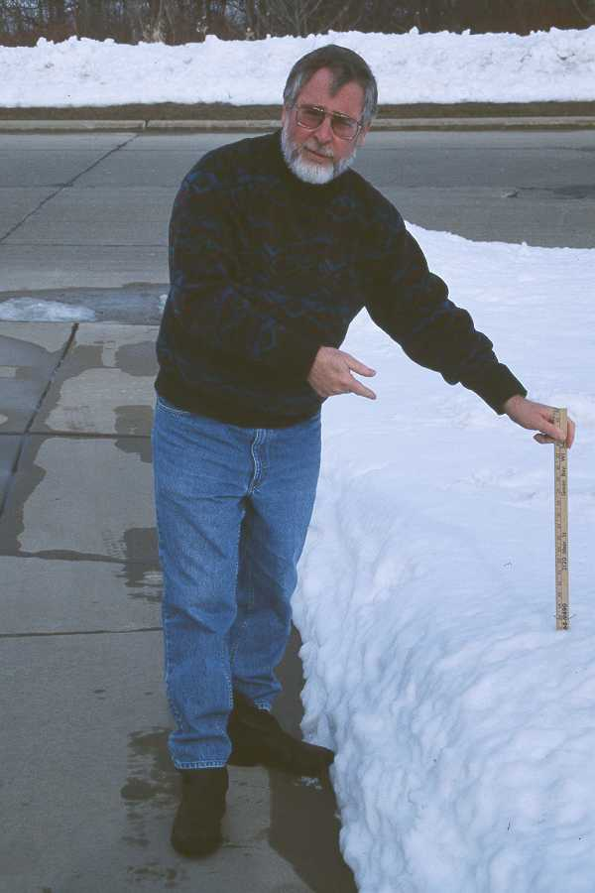
Who is that?
JOE MORAN

Slide 5
Overview
What’s Weather
What’s Climate
Why Climate
Wisconsin’s Seasons
Climates of the Past
Seasonal Outlook
Notes:
stories about how weather and climate are affecting our environment.

Slide 6
Additions
Slide on John Muir & school
Tornado
Snow
See also EJH-29Dec10.ppt
KFW16Jan
see
http://www.homefacts.com/tornadoes/Wisconsin/Dane-County/Oregon.html

Slide 7
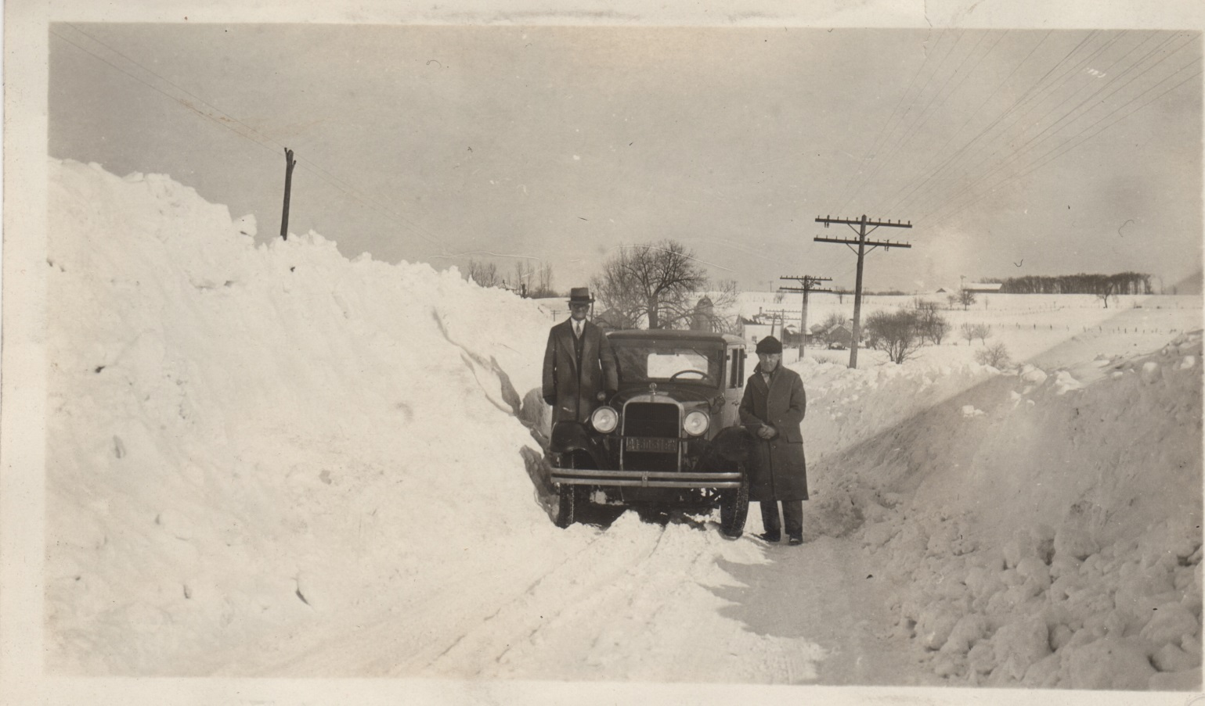
Wisconsin Snows of Yesteryear
ca. 1929 STH 106 (now 138) between Stoughton & Oregon
Courtesy: Melanie Woodworth
Notes:
\WI-BOOKS\1929snowstorm.jpg

Slide 8
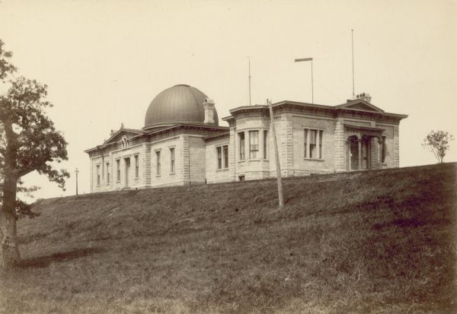
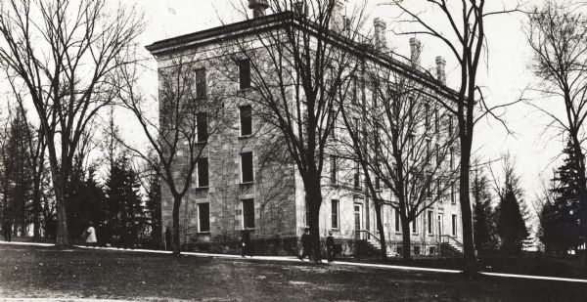
Site of Madison Weather Observations
Washburn Observatory
North Hall
Notes:
Washburn Obs WSHS http://images.wisconsinhistory.org/700099990712/9999010629-l.jpg
Exterior of Washburn Observatory at the University of Wisconsin-Madison, showing telephone wires.
RECORD DETAILS
Image ID: 1830
Creation Date: 1880 ca.
Creator Name: Isaacs, A. C., Madison, Wisconsin
City: Madison
County: Dane
State: Wisconsin
Collection Name: Place File***
Genre: Photograph
Original Format Type: photographic print, b&w
Original Format Number: PF Madison UW.625
Original Dimensions: 6.5 x 4.25 inches
See also http://images.wisconsinhistory.org/700010170008/1017000151-l.jpg
Also http://images.wisconsinhistory.org/700099990713/9999010642-l.jpg
North Hall 1910 ca

Slide 9
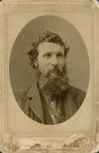
Notes:
John Muir http://images.wisconsinhistory.org/700099991172/9999016610-l.jpg
See Oregon School http://www.wisconsinhistory.org/wlhba_images/043/04300179.gif
See Muir’s iron thermometer
http://www.wisconsinhistory.org/Content.aspx?dsNav=Ny:True,Ro:40,Nrc:id-5,N:4294963828-4294955414&dsNavOnly=N:1135&dsRecordDetails=R:IM32861
http://images.wisconsinhistory.org/700005060004/0506000030-l.jpg

Slide 10
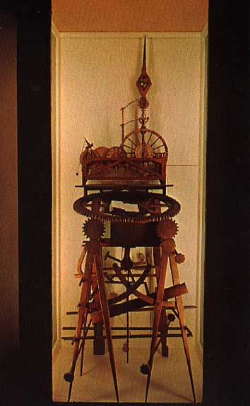
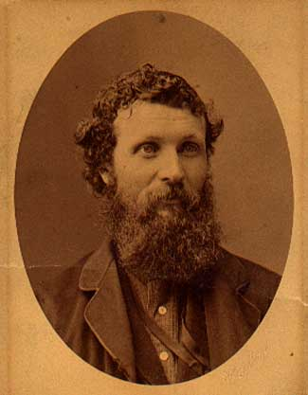
DID YOU KNOW THAT ...
John Muir (1838-1914) assisted Prof. J. Sterling with weather observations at the Univ.of Wisconsin in Madison during the1860s?

Slide 11
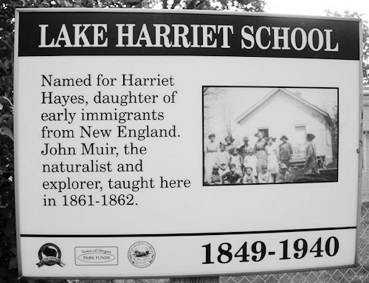
John Muir taught here (1861-62)!
Storytown Rd & Sun Valley Pkwy
From Oregon Area
Historical Society
Notes:
http://oregonareahistoricalsociety.org/documents/2014/country_schools_book.htm

Slide 12
What’s Weather
A snapshot of the atmosphere at a given time & place.
Such as seen on a “weather map”!

Slide 13
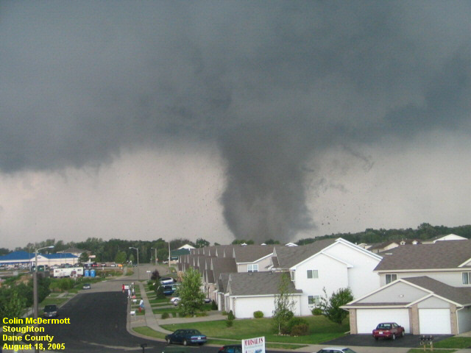
Stoughton tornado 18 Aug 2005
EF-3
One fatality
Tracked 20 mi from N of Oregon to N of Busseyville
https://en.wikipedia.org/wiki/August_2005_Wisconsin_tornado_outbreak
Notes:
https://en.wikipedia.org/wiki/August_2005_Wisconsin_tornado_outbreak#/media/File:Stoughton_Tornado.jpg

Slide 14
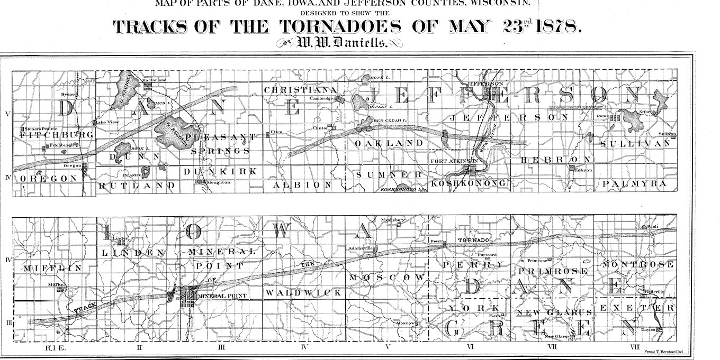
Tornado of 23 May 1878

Slide 15
Tornado of 23 May 1878
3:30 pm nr Mineral Point
Final death toll by county:
Iowa: 12
Dane: 6
Jefferson: 1
Total: 19
, six in Dane, and one in Jefferson.
Notes:
http://www.historicmadison.org/Madison's%20Past/connectingwithourpast/tornadoof1878.html

Slide 16
McFarland tornado 17 June 1992
F3
2 N Belleville to 1 N McFarland
At $18.0 million in damage this was the third costliest tornado in Wisconsin's history behind the Oakfield and Barneveld F5's.

Slide 17
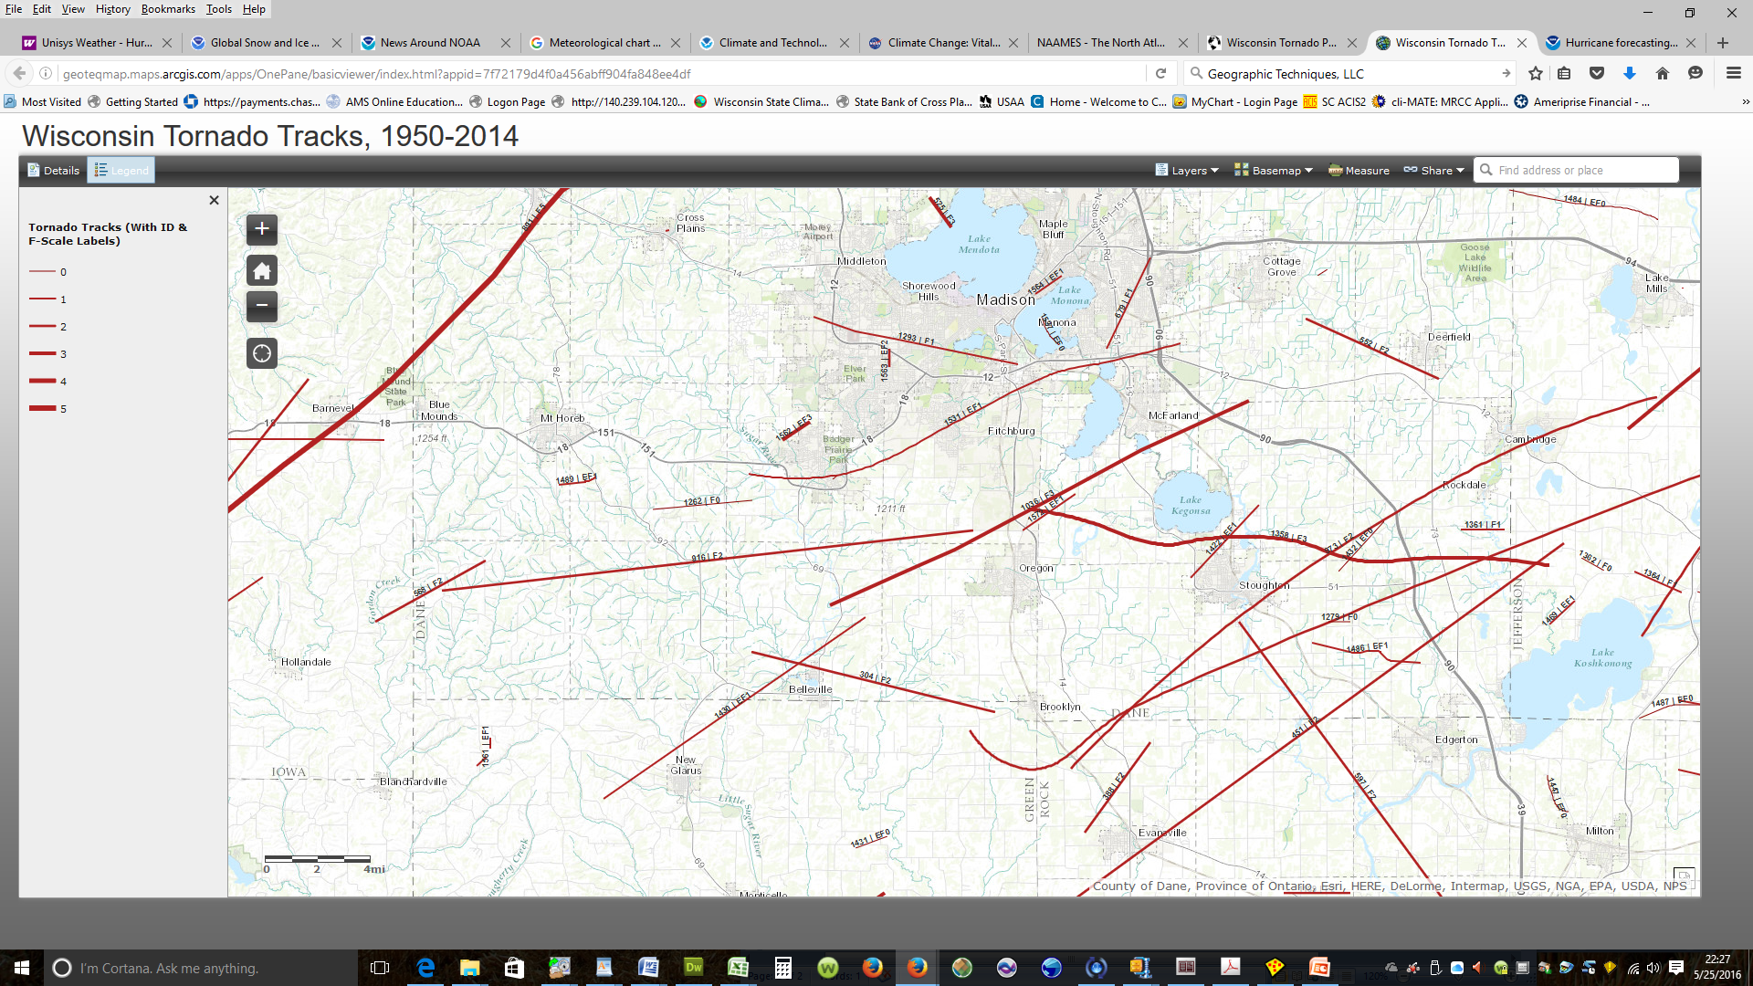
Wisconsin Tornado Project
Notes:
http://geoteqmap.maps.arcgis.com/apps/OnePane/basicviewer/index.html?appid=7f72179d4f0a456abff904fa848ee4df
http://www.geotechmap.org/Pages/WisTorProj.aspx

Slide 18
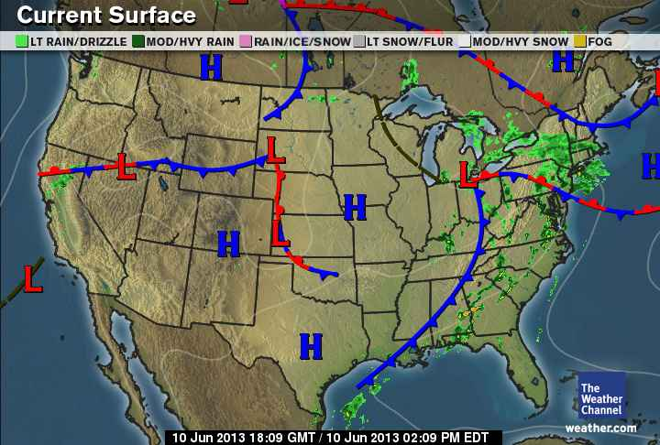
This Afternoon’s Weather Map
(The Weather Channel)
1 PM CDT In
Madison:
T = 77°F
Td = 62°F
RH = 60%
Variable Wind @5 mph
Today In
Madison:
Hi = 80°F
Lo = 58°F
Prec = ”
Notes:
http://maps.weather.com/images/maps/current/curwx_720x486.jpg
http://w1.weather.gov/data/obhistory/KMSN.html
http://www.nws.noaa.gov/climate/index.php?wfo=mkx
http://twister.sbs.ohio-state.edu/surface/charts/streamlines

Slide 19
Why Weather
Uneven temperatures on spherical earth
  Hot surface and cold atmosphere
  Hot tropics and cold poles
  Air flow needed to ease imbalances

Slide 20
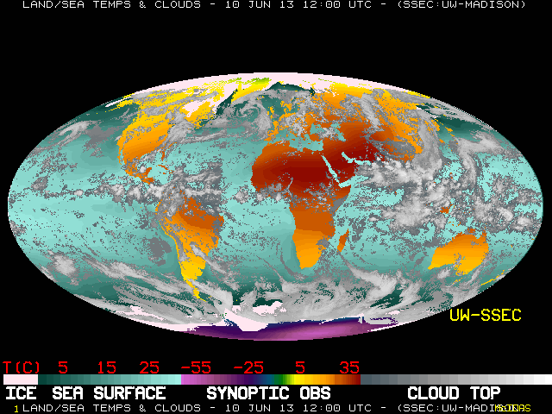
Clouds & surface temperatures from weather satellites (This morning)
Notes:
http://www.ssec.wisc.edu/data/comp/latest_cmoll.gif

Slide 21
Why Weather
Uneven temperatures on spherical earth
  Hot surface and cold atmosphere
  Hot tropics and cold poles
  Air flow needed to ease imbalances
Rotating earth
  Causes day-night cycle:
  helps moderate temperature variations
  Deflects movement of air around pressure systems:

Slide 22
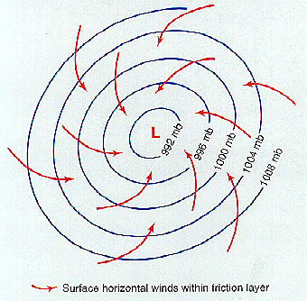
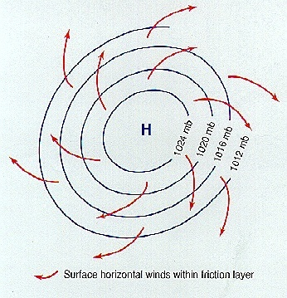
Map view of surface wind flow around Lows & Highs
Low Pressure
High Pressure
Notes:
Fig. 1.3A & Fig. 1.3B, Moran (2002)

Slide 23
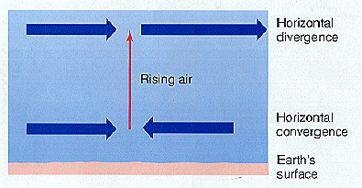
Surface Lows: Air Diverging Aloft
Moran & AMS Educ. Project
Cloudy skies, precip
& unsettled weather
L

Slide 24
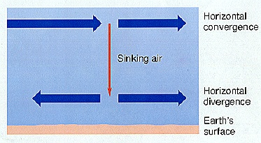
Surface Highs: Air Converging Aloft
Moran & AMS Educ. Project
Clear skies &
Fair weather
H
Notes:
Fig 8.20 Moran (2002)

Slide 25
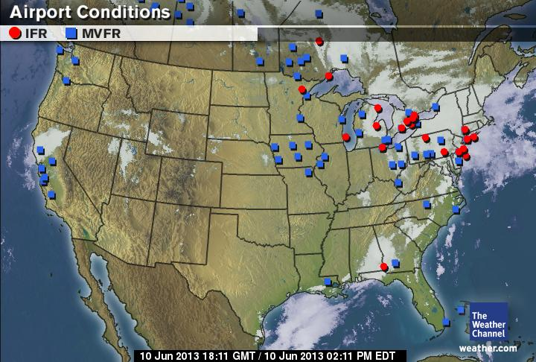

This Afternoon’s Weather Depiction
(The Weather Channel)
H
H
L
L
L
H
H
H
H
L
H
L
Notes:
http://image.weather.com/images/maps/aviation/avifr_720x486.jpg

Slide 26
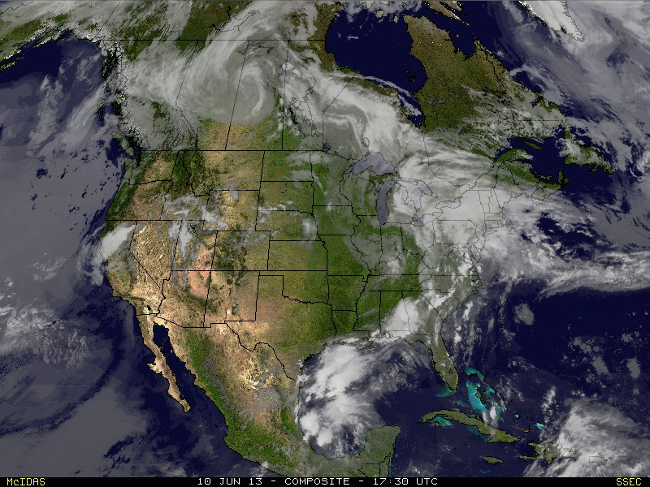
Composite Satellite Image
(from this afternoon)
Notes:
http://www.ssec.wisc.edu/data/us_comp/

Slide 27
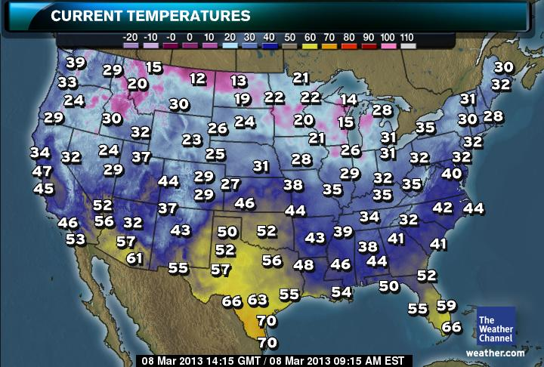
This Morning’s Air Temperatures
(The Weather Channel)
Notes:
http://maps.weather.com/images/maps/current/acttemp_720x486.jpg

Slide 28
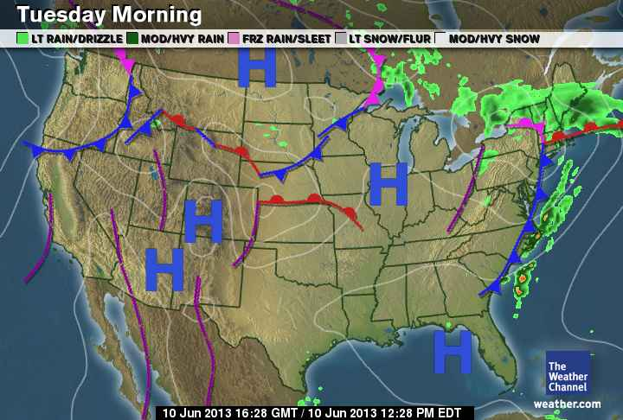
Tomorrow AM’s Forecast
(The Weather Channel)
Notes:
http://maps.weather.com/images/maps/forecast/amfcst_720x486.jpg

Slide 29
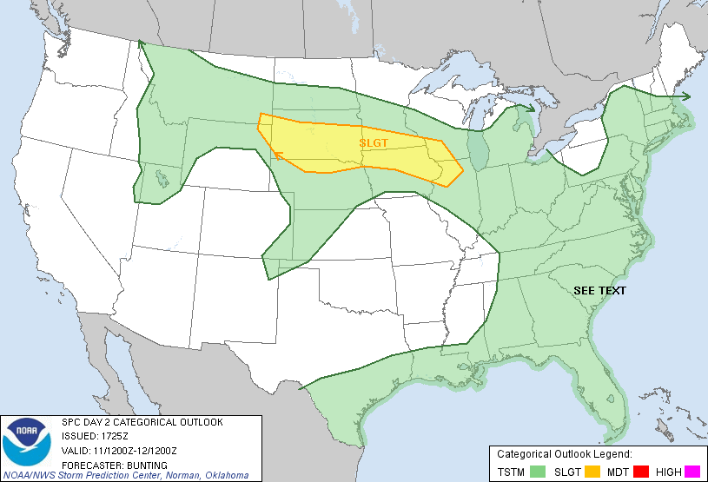
Threat of Severe Weather on Tuesday-Wednesday
[Source: Storm Prediction Center]
Notes:
http://www.spc.noaa.gov/products/outlook/day2otlk_1730.gif

Slide 30
What’s Climate
“Typical” weather conditions that define character of an area – e.g., Wisconsin
Often described as long-term averages (“normals”).
In addition to normals, characterize climate by:
- Weather extremes
  - Range of extreme weather events
  - Frequency of extreme weather events

Slide 31
What’s Climate
Depends upon:
  location
  season.
Remember:
“Climate is what you expect, weather is what you get.”

Slide 32
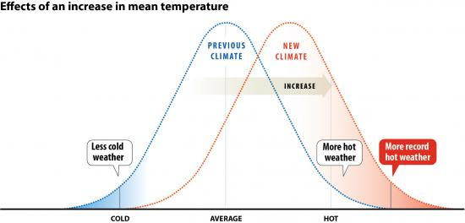
Changing Normals and Extremes
(Source: National Center for Atmospheric Research)
Notes:
http://www2.ucar.edu/currents/tail-record-heat
http://www2.ucar.edu/sites/default/files/news/2011/mean_increase3d1_1.jpg

Slide 33
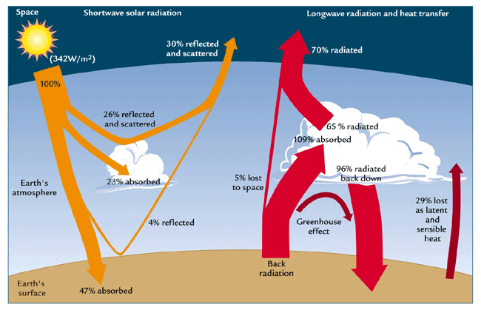
What drives climate
Incoming sunlight
Outgoing heat (infrared) radiation
Atmospheric & oceanic circulation

Slide 34
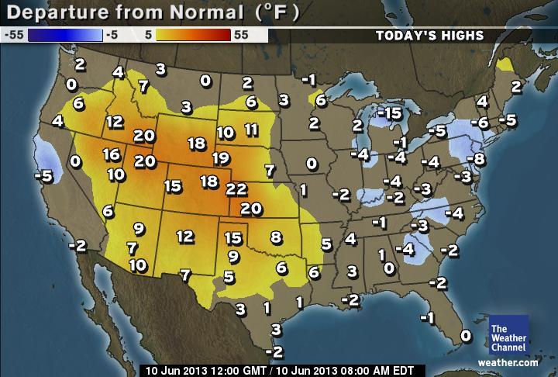
Comparing today’s projected high temperatures with the normals
(The Weather Channel)
Notes:
http://maps.weather.com/images/maps/special/norm_dep_hi_720x486.jpg

Slide 35
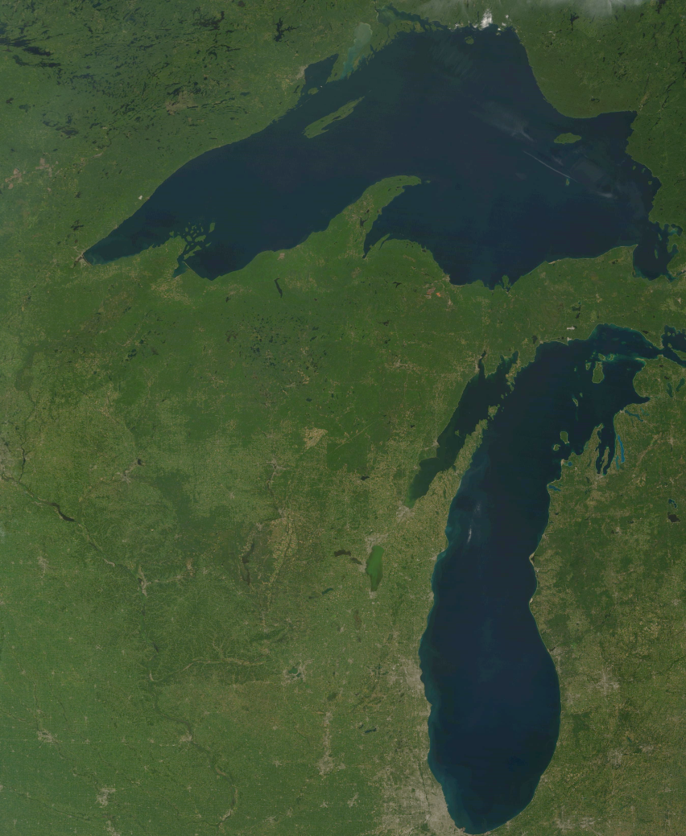
Wisconsin’s Weather & Climate
Boundary Conditions:
What defines and influences our weather and climate.
NASA MODIS image
WisconsinView
Notes:
http://arcsde.ersc.wisc.edu/modis/2008/2008244/t1.08244.Wisconsin.143.250m.jpg
35

Slide 36
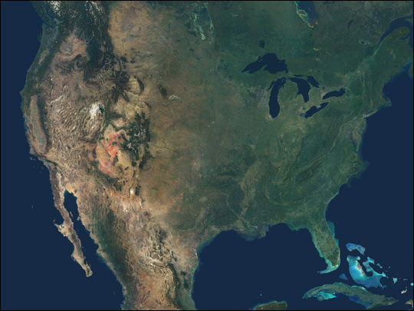
Wisconsin’s Weather & Climate
Boundary Conditions:
Mid-latitude location
Continental location
Proximity to Great Lakes
Location of Mountain Ranges (esp. Rockies)
Planetary scale atmospheric circulation
NASA Earth Observatory
Notes:
http://eoimages.gsfc.nasa.gov/images/imagerecords/4000/4597/PIA04361.jpg
36

Slide 37
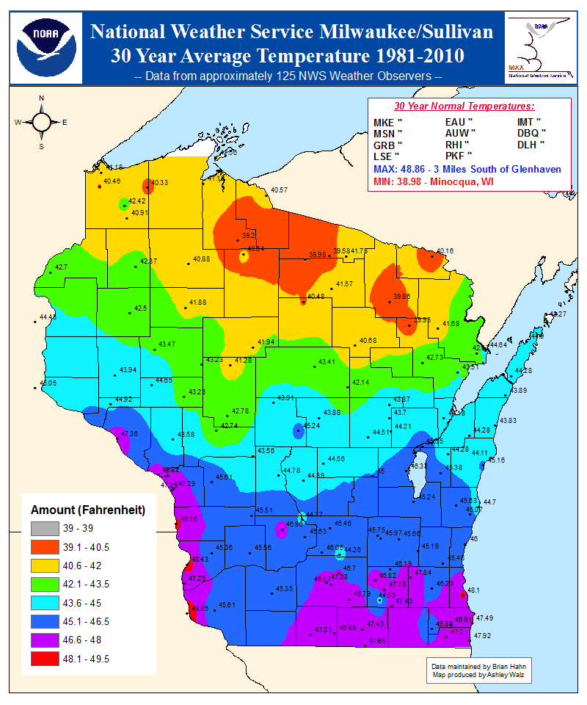
Average Annual Temperature (1981-2010)
State Ave
Temp:
^{43.7°F}
39°F
49°F
Notes:
http://www.crh.noaa.gov/images/mkx/climate/avg_30_year_temp.png

Slide 38
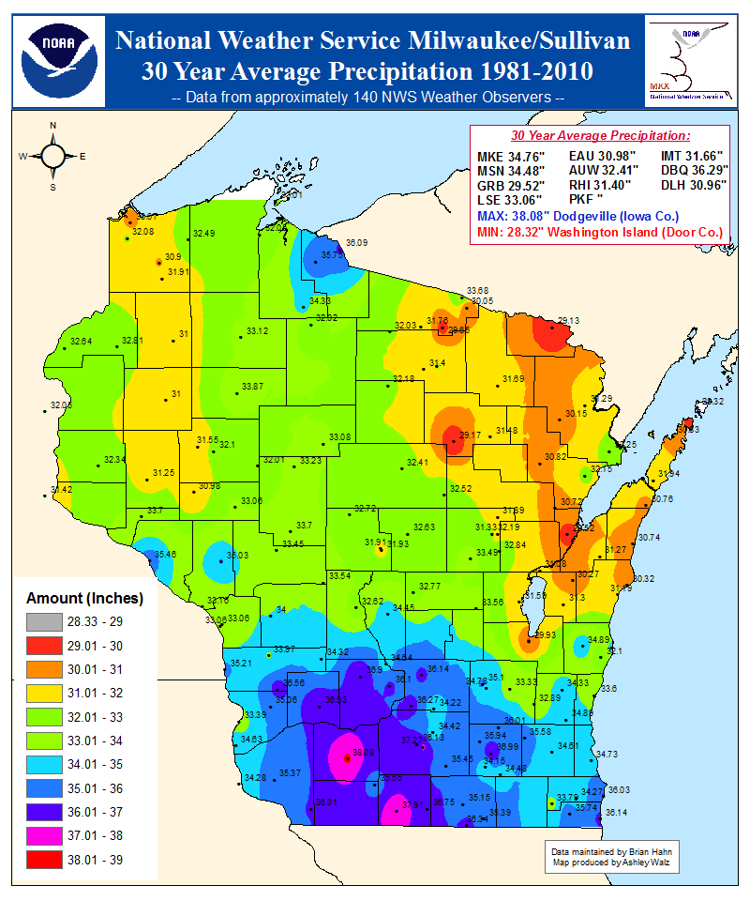
Average Annual Precipitation (1981-2010)
State Ave.
Precip
32.96 in.
28.32”
38.02”
Notes:
http://www.crh.noaa.gov/images/mkx/climate/avg_30_year_precip.png

Slide 39
Wisconsin Landscapes
Current weather patterns
The Tension Zone
Notes:
http://wisconsingeologicalsurvey.org/pdfs/pgszpdf/landscapes_of_wisconsin.pdf
See http://www.npwrc.usgs.gov/resource/plants/mnplant/intro.htm
39

Slide 40
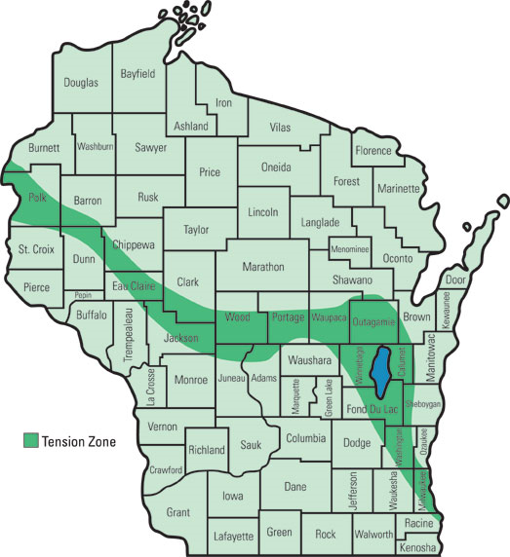
The Tension Zone
Arctic air
Boreal forest biome
Prairie Biome
Modified Pacific Air
From University of Wisconsin-Stevens Point
Notes:
https://www.uwsp.edu/natres/nres743/images/T1/TZsm_webthumb.jpg
40

Slide 41
Wisconsin Landscapes
Current weather patterns
The Tension Zone
Dictated by past climate of the Pleistocene (Ice Age)
Notes:
http://wisconsingeologicalsurvey.org/pdfs/pgszpdf/landscapes_of_wisconsin.pdf
See http://www.npwrc.usgs.gov/resource/plants/mnplant/intro.htm
41

Slide 42
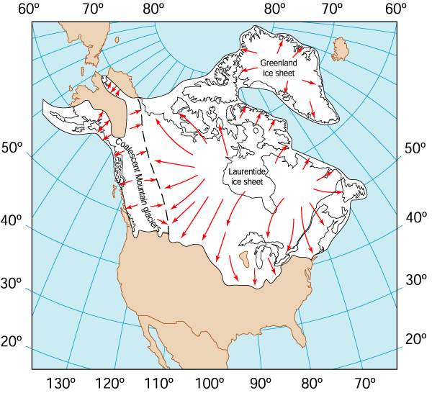
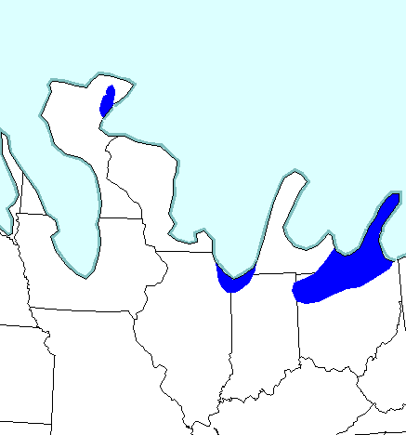
Last Ice Age
The Upper Midwest at 14,000 yr. BP
(from Illinois State Museum)
Notes:
42
http://museum.state.il.us/exhibits/larson/glacier_maps.html

Slide 43
Historic Legacy of an Ice Age
Glacial Lobes
Driftless
Region

Slide 44
What drives climate
Incoming sunlight
Outgoing heat (infrared) radiation
Atmospheric & oceanic circulation

Slide 45
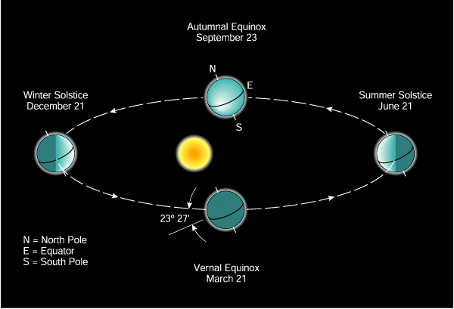
Earth’s Orbit of Sun –
The Cause of the Seasons
AMS Education, J.M. Moran (2002)
NH Winter Solstice
21 Dec -- Less Sunlight for NH
NH Summer Solstice
21 Jun -- More Sunlight for NH
-- But More Sunlight for SH
-- But Less Sunlight for SH

Slide 46
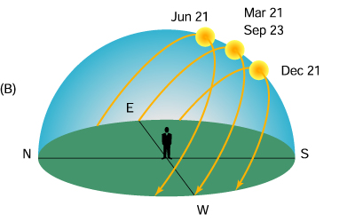
Sun Paths for Mid Latitudes
Moran & Amer. Meteor. Soc. Education Program

Slide 47
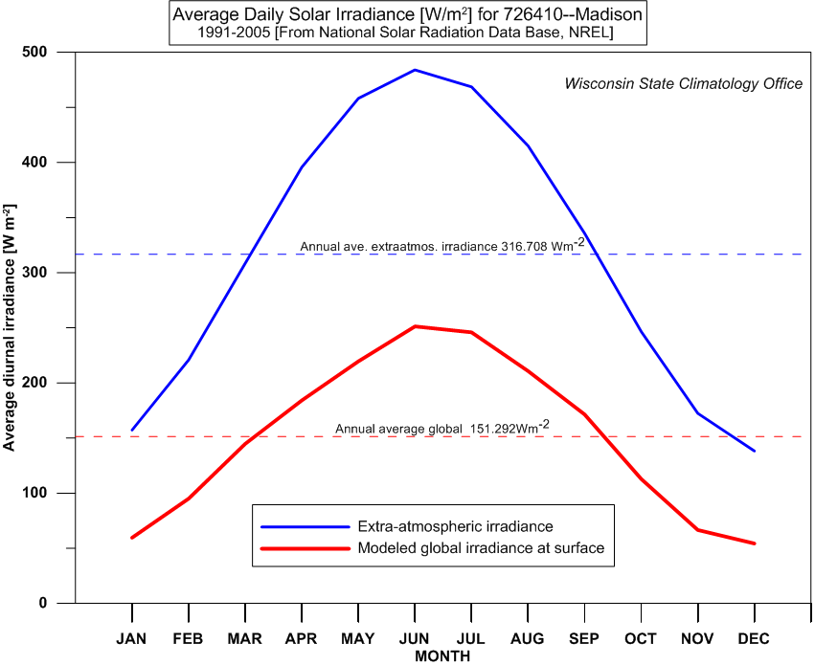
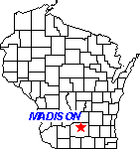
Incoming solar energy reaching Madison
Notes:
C:\Users\Ed\Documents\CLIMO\WI-CLIMO\WI-STATIONS\WI-SOLAR\WI-NSRDB-1991-2005_data\WI-NSRDB-NCDC-1991-2005-D-dsf-datafiles\MSN-726410-NSRDB-91-05.gif

Slide 48
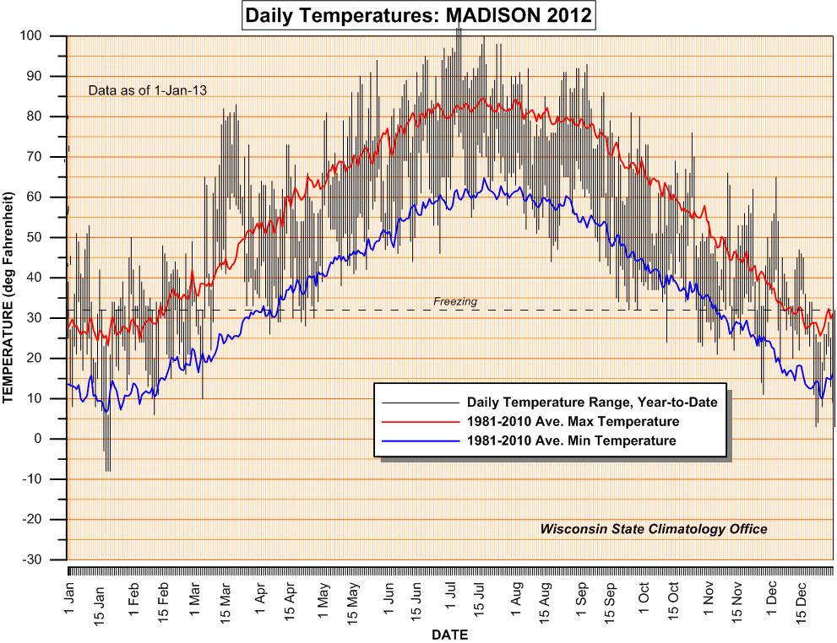
Daily & Seasonal Temperature Response at Madison
Highest ave. temperatures
In mid July
Summer
Solstice on 21 June
Winter
Solstice on 21 Dec
Lowest ave. temperatures
In mid Jan
Notes:
http://www.aos.wisc.edu/~sco/clim-history/stations/msn/msn-tts-2011.gif

Slide 49
Seasons
 | Meteorological | Astronomical
Summer | June, July, August | 21 Jun - 21 Sep
Autumn | September, October, November | 21 Sep - 21 Dec
Winter | December, January, February | 21 Dec – 21 Mar
Spring | March, April, May | 21 Mar -21 Jun

Slide 50
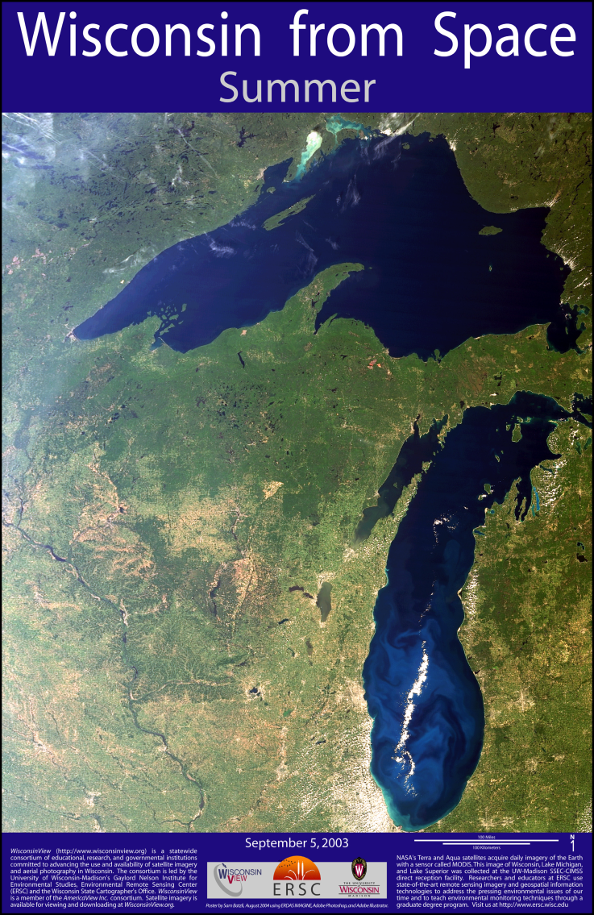
Summer (JJA) in Wisconsin
15-15½ hours of sunlight
Tropical air sweeps north
Highest temperature
114° F in July 1936
Annual number of
90-degree days (max T ≥ 90°F):
2 in north central
18 in southwest
30-40 thunderstorm days/ yr.
Height of severe weather season (June most tornadoes)
Notes:
http://relief.ersc.wisc.edu/wisconsinview/documents/posters/wisconsin_from_space_summer.pdf
50

Slide 51
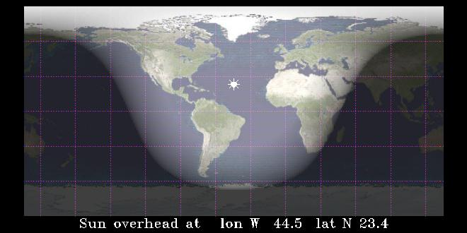
DAYLIGHT-NIGHT (21 JUN) at 10 AM CDT (Source: US Naval Observatory)
24 hr
12 hr
0 hr
Notes:
http://aa.usno.navy.mil/

Slide 52
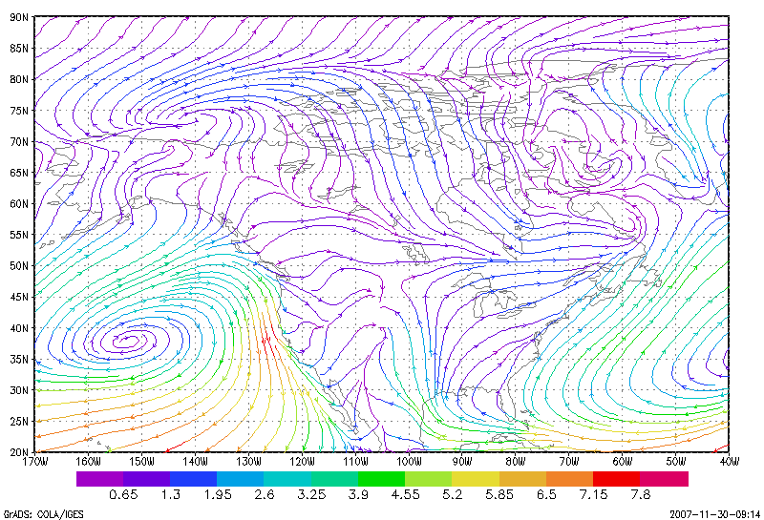
July average surface winds
Notes:
http://www.lpc.uottawa.ca/publications/july_mean_streamline_maps_era-40.pdf
Figure C24. Mean July 10m Streamlines (in m/s) for 1958-2002 from the ERA-40 reanalysis.

Slide 53
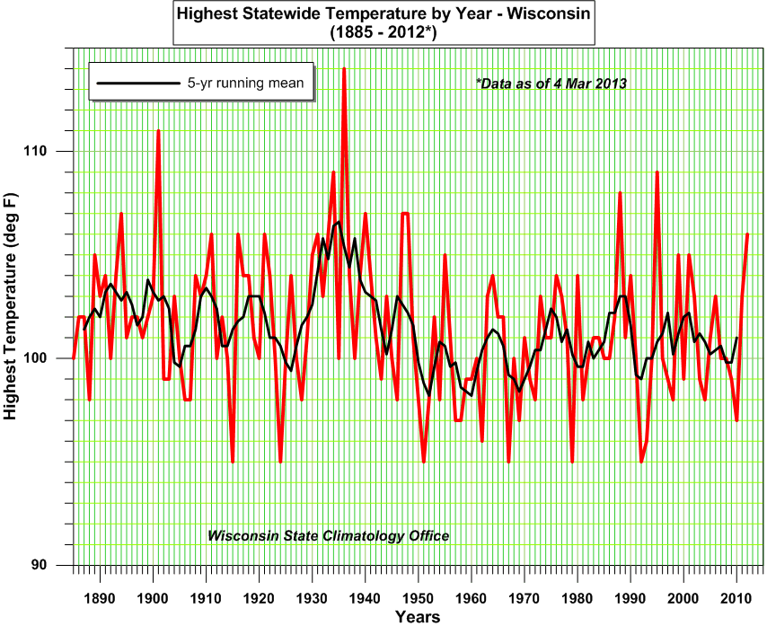
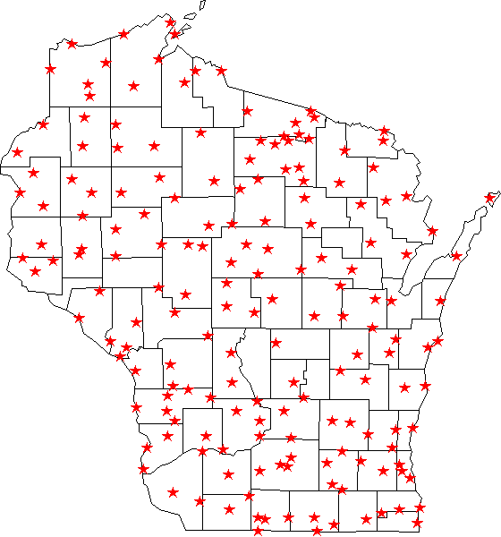
Extremely High Summer Temperatures in Wisconsin
114°F in 1936
Wisconsin Dells
Notes:
53
http://www.aos.wisc.edu/~sco/clim-history/state/graphics/WI-HIGH-T-ANN.gif

Slide 54
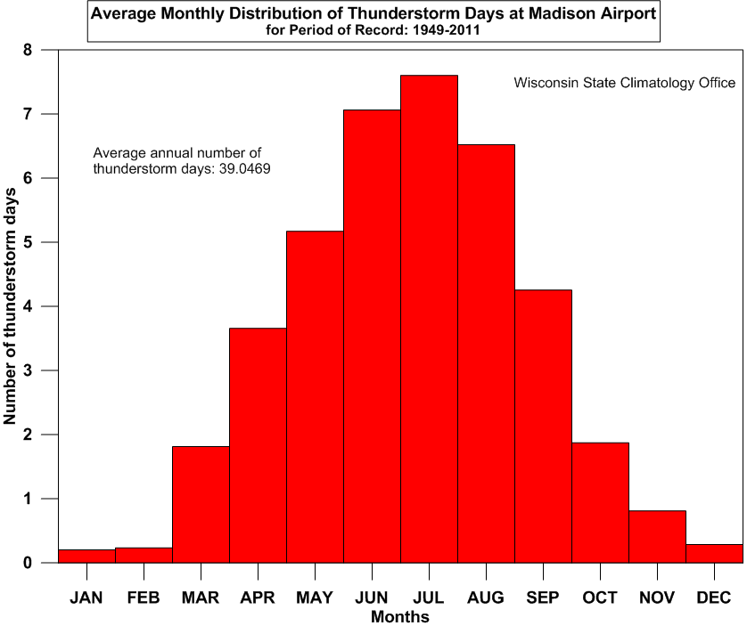
Thunderstorm Days in Madison –over the year
Notes:
54
http://www.aos.wisc.edu/~sco/clim-history/stations/msn/MSN-AP-TRWD-M-AV.gif

Slide 55
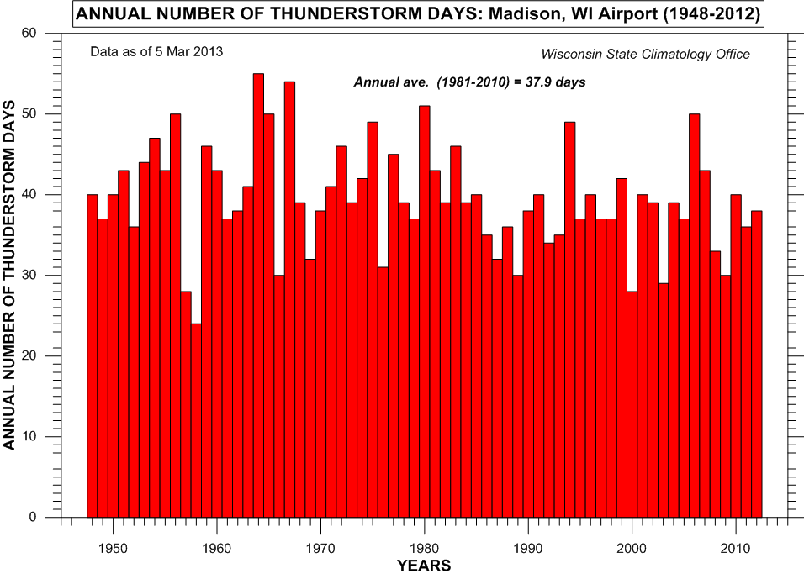
Thunderstorm Days in Madison –over 60 years
38 Thunderstorm days in 2012
Notes:
55
http://www.aos.wisc.edu/~sco/clim-history/stations/msn/MSN-AP-TRWD-ANN.gif

Slide 56
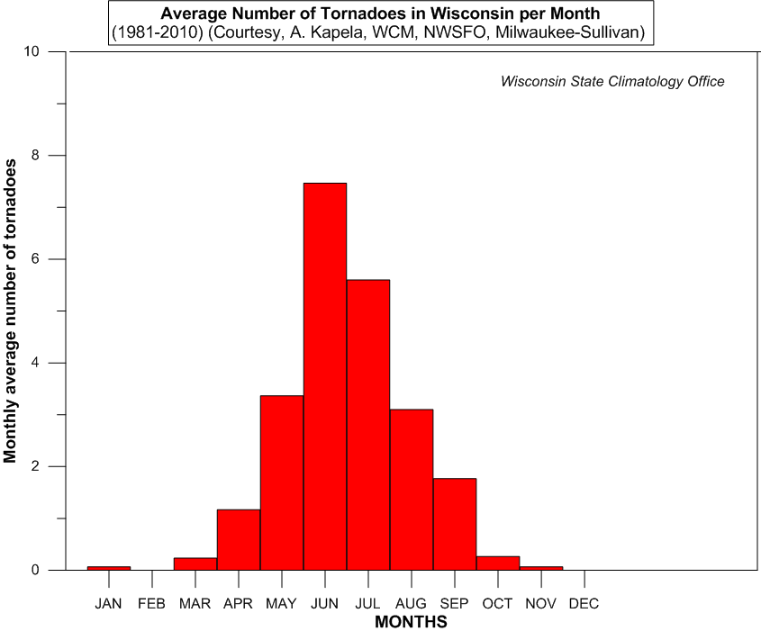

Slide 57
In Remembrance:
Barneveld Tornado of 8 Jun 1984
  Strong F-5 tornado
  Struck Barneveld at 1 AM
  90% of town damaged or destroyed
  9 people killed
  Only one of 7 tornadoes in
  southern Wisconsin that morning
Notes:
http://www.crh.noaa.gov/mkx/document/tor/images/tor060884/damage-6.jpg

Slide 58
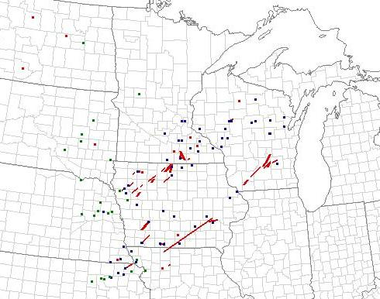
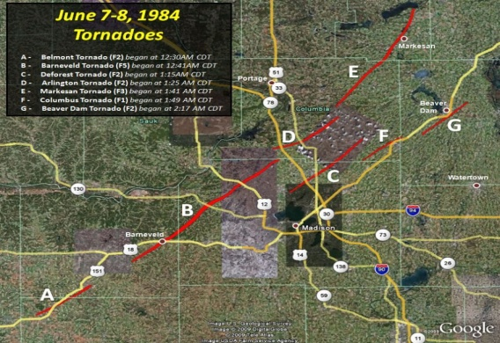
Barneveld Tornado
From Milwaukee/Sullivan NWSFO
Notes:
http://www.crh.noaa.gov/images/mkx/wx_events/tornado/060884/spcreportsmap.JPG
http://www.crh.noaa.gov/images/mkx/wx_events/tornado/060884/mkx_fujitamap.PNG
http://www.crh.noaa.gov/mkx/?n=barneveldf5tornado

Slide 59
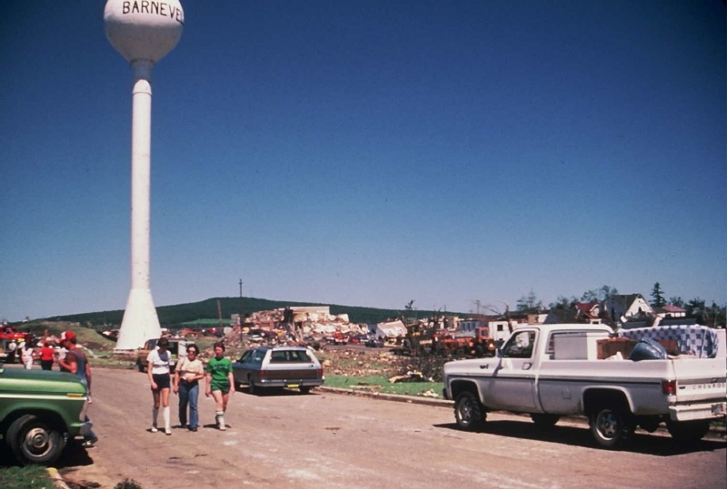
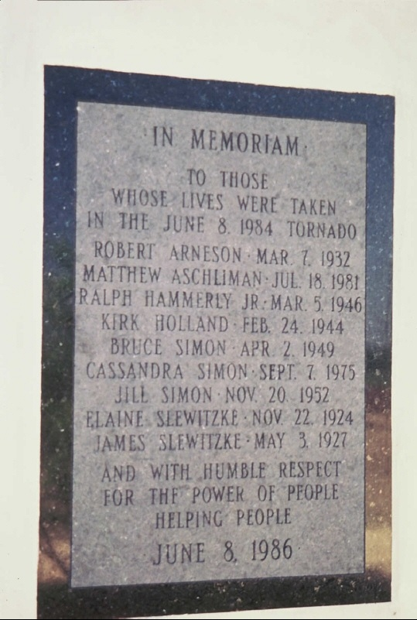
Barneveld Tornado
From Milwaukee/Sullivan NWSFO
Notes:
http://www.crh.noaa.gov/mkx/document/tor/images/tor060884/damage-6.jpg
http://www.crh.noaa.gov/mkx/document/tor/images/tor060884/damage-7.jpg
http://www.crh.noaa.gov/mkx/?n=barneveldf5tornado

Slide 60

F5/EF5 Tornadoes in Wisconsin since 1950
Oakfield
18 July 1996
Barneveld
8 June 1984
Baldwin-
Menomonie-Colfax
4 June 1958
60 F5/EF5 thru
6 June 2013 in US
Source: Storm Prediction Center
1950’s 13, 1960’s 11; 1970’s 13; 1980’s 6; 1990’s 7; 2000’s 2; 2010’s 8
Notes:
http://www.spc.noaa.gov/faq/tornado/usf5tors.gif

Slide 61

Wisconsin Tornado Count over Time
Notes:
http://www.aos.wisc.edu/~sco/seasons/graphics/WI-tornado_no-t-s-fscale-bar.gif

Slide 62

Notes:
http://www.crh.noaa.gov/images/mkx/severe/tor-event-death-injury.gif

Slide 63

Notes:
http://www.crh.noaa.gov/images/mkx/severe/tstormwind.gif

Slide 64

Summer heat waves in Madison
90ºF days in 2012: 39
Notes:
64
http://www.aos.wisc.edu/~sco/clim-history/stations/msn/MSN-AP-90degdays-ann.gif

Slide 65

Notes:
http://www.crh.noaa.gov/images/mkx/severe/htwaveevents.gif

Slide 66

Autumn (SON) in Wisconsin
Fall coloration –
  End of August through late October
First frost of season
Indian Summer
Migratory birds head south
First measurable snow
First major winter storms:
The “Gales of November”
Notes:
http://relief.ersc.wisc.edu/wisconsinview/documents/posters/wisconsin_from_space_fall.pdf
66

Slide 67

From The Weather Channel
Notes:
http://image.weather.com/images/maps/special/fall_peak_mw_720x486.jpg

Slide 68

DAYLIGHT-NIGHT (21 SEP) at 10 AM CDT (Source: US Naval Observatory)
12 hr
12 hr
12 hr
Notes:
http://aa.usno.navy.mil/
http://aa.usno.navy.mil/
http://aa.usno.navy.mil/

Slide 69

October average surface winds
Notes:
http://www.lpc.uottawa.ca/publications/july_mean_streamline_maps_era-40.pdf
Figure C59. Mean October 10m Streamlines (in m/s) for 1958-2002 from the ERA-40 reanalysis

Slide 70

Median Date of First 32°F in Fall
1-10 Oct
Notes:
http://www.crh.noaa.gov/images/mkx/climate/FallFirstFreeze.png

Slide 71

Length of the Growing Season In Madison
Notes:
http://www.aos.wisc.edu/~sco/clim-history/stations/msn/MSN-AP-grwingseadays.gif

Slide 72
Hurricanes and Wisconsin?
Source: NOAA’s Historical Hurricane Tracks
“Issac’s Storm” (Cat 4) 1900
Carla 1961- Cat 5
Gilbert 1988 –Cat 5
Notes:
http://csc.noaa.gov/hurricanes/#

Slide 73

Median date of 1st Measurable Snow (≥ 0.1 in)
10 Nov
Notes:
http://mrcc.isws.illinois.edu/cliwatch/snow_maps/firstsnow_median_stn_Central.png

Slide 74

Principal Storm Tracks across US
Moran & AMS Educ. Project

Slide 75

“Gales of November”
Last Trip of the Edmund Fitzgerald
10 November 1975
SS Edmund Fitzgerald –
“The Pride of the American side”
Notes:
http://www.edmundfitzgerald.com/

Slide 76

Winter (DJF) in Wisconsin
8½-9 hours of sunlight
Arctic air masses move south
The Ice Bowl(s)
Ice covers lakes
40 to 160 inches of snow
60-140 days of snow on ground (≥ 1.0 inches)
Lowest temperature:
-55° F in Feb 1996
Annual number of subzero days (min T ≤ 0°F) :
15 in southeast
50 in northwest
Notes:
http://relief.ersc.wisc.edu/wisconsinview/documents/posters/wisconsin_from_space_winter.pdf
76

Slide 77

DAYLIGHT-NIGHT (21 DEC) at 9 AM CST (Source: US Naval Observatory)
0 hr
12 hr
24 hr
Notes:
http://aa.usno.navy.mil/

Slide 78

January average surface winds
Notes:
http://www.lpc.uottawa.ca/publications/july_mean_streamline_maps_era-40.pdf
Figure C2. Mean January 10m Streamlines (in m/s) for 1958-2002 from the ERA-40 reanalysis

Slide 79

Extremely Low Winter Temperatures in Wisconsin
-55°F in 1996
nr Couderay
Notes:
79
http://www.aos.wisc.edu/~sco/clim-history/state/graphics/WI-LOW-T-ANN.gif

Slide 80

Average Annual Snowfall (1981-2010)
Max. Seasonal
Snow
167.5 in @ Hurley
State Ave
Snow:
52.9 in
Min. Seasonal
Snow
31.9 in @ Beloit
Notes:
http://www.crh.noaa.gov/images/mkx/climate/avg_30_year_snowfall.png

Slide 81
Wisconsin Snows of Yesteryear
ca. 1929 State Hwy 106 between Stoughton & Oregon
Notes:
\WI-BOOKS\1929snowstorm.jpg

Slide 82

Ice Bowl – NFL Championship Game
31 Dec 1967
Lambeau Field, Green Bay
Noon Air Temp
-14ºF
Lowest Wind chill
-37ºF
Packers 21- Cowboys 17
Notes:
https://encrypted-tbn2.gstatic.com/images?q=tbn:ANd9GcSwv-JxE79Sa-rM3fcIeiMT9m8ZrhwLODkDBUkBk4WERZMdgWFyqzoX26EP

Slide 83

Notes:
http://www.crh.noaa.gov/images/mkx/severe/icestorms.gif

Slide 84

Notes:
http://www.crh.noaa.gov/images/mkx/severe/winterstorms.gif

Slide 85

Notes:
http://www.crh.noaa.gov/images/mkx/severe/blizzards.gif

Slide 86

Notes:
http://www.crh.noaa.gov/images/mkx/severe/flood.gif

Slide 87

Arctic Blasts in Madison
8 days so far
this season
Notes:
http://www.aos.wisc.edu/~sco/clim-history/stations/msn/msn-ap-d_tn_le_0F_ann.gif

Slide 88

Days with Snow cover in Madison
Currently 83 days with snow cover
Notes:
http://www.aos.wisc.edu/~sco/clim-history/stations/msn/MSN-AP-DaysSnwCovGE1.gif

Slide 89

Madison skyline from
Frozen Lake Monona

Slide 90



Ice Cover on Lake Mendota
Notes:
http://www.aos.wisc.edu/~sco/lakes/mendota-dur.gif

Slide 91

PLANT HARDINESS ZONES
[Average Annual Extreme Minimum Temperatures]
(Source: USDA)
3: -40 to -30F
4: -30 to -20F
5: -20 to -10F
Notes:
http://planthardiness.ars.usda.gov/PHZMWeb/Images/72DPI/wi.jpg

Slide 92

PLANT HARDINESS ZONES
[Average Annual Extreme Minimum Temperatures]
(Source: USDA)
PHZM 3: -40 to -30F; 4: -30 to -20F; 5: -20 to -10F
Notes:
http://www.transcend.ws/wp-content/uploads/2012/03/USDAPlantHardinessZoneMaps1990to2012.png
From http://www.transcend.ws/usda-updates-plant-hardiness-zone-map-minimum-winter-temperatures-rise/

Slide 93

Spring (MAM) in Wisconsin
Increased daylight
Return of warm air
First thunderstorms
Ice comes off the lakes
Last frost in spring
Last snow
Return of migratory birds
“Green-up” spreads north
Sap for maple syrup runs
Notes:
http://relief.ersc.wisc.edu/wisconsinview/documents/posters/wisconsin_from_space_spring.pdf
93

Slide 94




“Green-up” seen from space
(NOAA/ National Environmental Satellite Data Information Service)
NDVI =
Normalized Difference
Vegetation Index
-- shows vegetation
distribution
& healthy vegetation
Notes:
http://www.star.nesdis.noaa.gov/smcd/emb/vci/VH/vh_imageloop.php
http://www.star.nesdis.noaa.gov/smcd/emb/vci/VH/regional_image.php?name=USA&latmin=25.0&latmax=51.0&lonmin=-126.0&lonmax=-63.0&sample=1&file=../gvix_webImages/2011/WorldBig_SMN_201151.png
See http://www.drought.gov/workshops/remotesensing/presentations/NIDIS_kogan_presen.pdf
http://www.star.nesdis.noaa.gov/smcd/emb/vci/VH/vh_browse.php
http://www.star.nesdis.noaa.gov/smcd/emb/vci/VH/vh_imageloop.php

Slide 95

DAYLIGHT-NIGHT (21 MAR) at 10 AM CDT (Source: US Naval Observatory)
12 hr
12 hr
12 hr
Notes:
http://aa.usno.navy.mil/

Slide 96

April average surface winds
Notes:
http://www.lpc.uottawa.ca/publications/july_mean_streamline_maps_era-40.pdf
Figure C5. Mean April 10m Streamlines (in m/s) for 1958-2002 from the ERA-40 reanalysis.

Slide 97

Median Date of Last 32°F in Spring
1-10 May
Notes:
http://www.crh.noaa.gov/images/mkx/climate/springlastfreeze.png

Slide 98

Notes:
http://www.aos.wisc.edu/~sco/clim-history/stations/msn/msn-gddu-2012.gif

Slide 99
Is Climate Changing?
Has it changed in the past?
Will it change in the future?
But how can we tell? …
Notes:
99
See figs
http://www.ncdc.noaa.gov/paleo/paleo.html

Slide 100
Common Fallacies
Climate is constant!
Current atmospheric warming is unprecedented and unique!
Notes:
100

Slide 101


Views of State Climatology Office
Notes:
101

Slide 102


Changing Climate
In Instrumental Data Period
1930s
1990s
Notes:
http://www.photolib.noaa.gov/700s/wea00903.jpg
ASOS from Fig 1.03 jpg of AMS Wx Studies 2009
102

Slide 103

19th Century Weather Data

Slide 104
Some of long-term Weather Stations in Wisconsin
Notes:
104

Slide 105

Weather Stations in the Old Northwest
(in 1831)
Ft. Howard
Ft. Crawford
Ft. Winnebago

Slide 106

19th Century Wisconsin
Ft. Winnebago near Portage
“…it is manifest that this station is highly salubrious.”
Dr. Samuel Forry, 1842 in
“The Climate of the United States and its Endemic Influences”

Slide 107

Early Wisconsin “campers”
Rock shelter at Natural Bridge State Park
ca 9000-8000 BC
Notes:
A partial excavation at the site revealed Woodfordian and Archaic inhabitant artifacts with earliest estimates of human occupation between 9000 and 8000 B.C. Animal remains identified include 15 mollusk species and 50 vertebrate species.

Slide 108
Where do we stand this year?

Slide 109

Notes:
http://www.aos.wisc.edu/~sco/clim-history/stations/msn/msn-tts-2013.gif

Slide 110
Notes:
http://www.aos.wisc.edu/~sco/clim-history/stations/msn/msn-tts-2012.gif

Slide 111


A cool & wet spring
Temperature departure
Precipitation - % of Normal
Notes:
http://www.aos.wisc.edu/~sco/mrcc_images/tmeandev-90days.png
http://www.aos.wisc.edu/~sco/mrcc_images/prcpdev2-90days.png

Slide 112

MONTHLY AVERAGE TEMPERATURES:
Fort Winnebago 1831-32, 1835-45 Average
Portage: 1971-2000 Normal [Source: NCDC]

Slide 113

Current Drought Conditions
(National Drought Mitigation Center)
Notes:
http://droughtmonitor.unl.edu/2013/drmon0604.gif

Slide 114


Comparison
Last Summer & Now
(National Drought Mitigation Center)
Last summer (24 Jul 2012)
This week (6 Jun 2013)
Notes:
http://droughtmonitor.unl.edu/archive/20120724/pics/WI_dm_120724.png
http://droughtmonitor.unl.edu/archive/20130305/pics/WI_dm_130305.png

Slide 115


June 2013 Outlook
From NOAA Climate Prediction Center
Temperature Outlook
Precipitation Outlook
Notes:
http://www.cpc.ncep.noaa.gov/products/predictions/30day/off14_temp.gif
http://www.cpc.ncep.noaa.gov/products/predictions/30day/off14_prcp.gif
115

Slide 116
Looking Ahead to Summer

Slide 117


Summer (JJA) 2013 Outlook
From NOAA Climate Prediction Center
Temperature Outlook
Precipitation Outlook
Notes:
http://www.cpc.ncep.noaa.gov/products/predictions/long_range/lead01/off01_temp.gif
http://www.cpc.ncep.noaa.gov/products/predictions/long_range/lead01/off01_prcp.gif
117

Slide 118

Climate Outlook (Forecast)
From NOAA Climate Prediction Center
Notes:
http://www.cpc.noaa.gov/products/expert_assessment/seasonal_drought.html
http://www.cpc.ncep.noaa.gov/products/expert_assessment/season_drought.gif

Slide 119

The Wisconsin State Climatology Office Web Page http://www.aos.wisc.edu/~sco
Notes:
119
http://www.aos.wisc.edu/~sco/

Slide 120

Thank You!
Ed Hopkins
ejhopkin@wisc.edu
State Climatology Office
1225 W. Dayton St.,
Madison, WI 53706
http://www.aos.wisc.edu/~sco
Notes:
120

Slide 121



Outlook for El Niño/La Niña? From NOAA Climate Prediction Center
Winter
El Niño
Summer
Fall
Notes:
http://www.cpc.ncep.noaa.gov/www_images/PP.gif
http://www.cpc.ncep.noaa.gov/products/analysis_monitoring/lanina/enso_evolution-status-fcsts-web.ppt

Slide 122


Global SST Departures (ºC)
From NOAA Climate Prediction Center
Notes:
http://www.cpc.ncep.noaa.gov/products/analysis_monitoring/lanina/enso_evolution-status-fcsts-web.ppt

Slide 123


Trends in Wisconsin’s Spring Temperature
Notes:
123
http://www.aos.wisc.edu/~sco/seasons/graphics/WI-00-temp-mam.gif

Slide 124

Trends in Wisconsin’s Summer Temperature
Notes:
124
http://www.aos.wisc.edu/~sco/seasons/graphics/WI-00-temp-son.gif

Slide 125

Trends in Wisconsin’s Autumn Temperature
Notes:
125
http://www.aos.wisc.edu/~sco/seasons/graphics/WI-00-temp-son.gif

Slide 126

Trends in Wisconsin’s Winter Temperature
Notes:
126
http://www.aos.wisc.edu/~sco/seasons/graphics/WI-00-temp-djf.gif

Slide 127


Notes:
http://image.weather.com/images/maps/special/fall_peak_us_720x486.jpg

Slide 128

Lake Delton Washout
9 Jun 2008
Notes:
http://en.wikipedia.org/wiki/File:New_Dell_Creek_Channel_draining_Lake_Delton_with_wrecked_homes.jpg
from http://en.wikipedia.org/wiki/Lake_Delton

Slide 129
Views of State Climatology Office
Notes:
129

Slide 130
Changing Climate
In Instrumental Data Period
1930s
1990s
Notes:
http://www.photolib.noaa.gov/700s/wea00903.jpg
ASOS from Fig 1.03 jpg of AMS Wx Studies 2009
130

Slide 131
19th Century Weather Data

Slide 132
Some of long-term Weather Stations in Wisconsin
Notes:
132

Slide 133
Weather Stations in the Old Northwest
(in 1831)
Ft. Howard
Ft. Crawford
Ft. Winnebago

Slide 134
19th Century Wisconsin
Ft. Winnebago near Portage
“…it is manifest that this station is highly salubrious.”
Dr. Samuel Forry, 1842 in
“The Climate of the United States and its Endemic Influences”

Slide 135
MONTHLY AVERAGE TEMPERATURES:
Fort Winnebago 1831-32, 1835-45 Average
Portage: 1971-2000 Normal [Source: NCDC]

Slide 136
Trends in Climate “Normals” & Extremes
Trends in “Normals” or expectations
Monitoring the climate elements
Trends in Extremes
Investigating station extremes:
  Extreme temperature
  Extreme 24-hr precipitation events
  Multi-day precipitation extremes
Notes:
136

Slide 137
Changing Normals and Extremes
(Source: National Center for Atmospheric Research)
Notes:
http://www2.ucar.edu/currents/tail-record-heat
http://www2.ucar.edu/sites/default/files/news/2011/mean_increase3d1_1.jpg

Slide 138
Madison skyline from
Frozen Lake Monona

Slide 139
Ice Cover on Lake Mendota
Notes:
http://www.aos.wisc.edu/~sco/lakes/mendota-dur.gif

Slide 140


Earlier arrival of spring in Wisconsin
Bird migration | Vegetation
Geese Arrival: 29 days earlier | Baptista first bloom: 18 days earlier
Cardinal first song: 22 days earlier | Butterflyweed first bloom: 18 days earlier
Robin arrival: 9 days earlier | Marshmilkweed first bloom: 13 days earlier
Nina Leopold Bradley
Photo: Jeffrey Phelps, Milw. Journal Sentinel
55 ecological indicators of spring occurred on average
1.2 days earlier per decade from 1936 to 1998.
Source: Bradley et al., 1999. Phenological changes reflect climate change in Wisconsin. Proc. Natl. Acad. Sci., 96: 9701-9704.
Slide adapted from C. Kucharik, UW-Madison
Leopold Shack
Photo: Aldo Leopold Foundation
Notes:
140

Slide 141
Rock shelter at Natural Bridge State Park
Early “campers” ca 9000-8000 BC
Notes:
A partial excavation at the site revealed Woodfordian and Archaic inhabitant artifacts with earliest estimates of human occupation between 9000 and 8000 B.C. Animal remains identified include 15 mollusk species and 50 vertebrate species.

Slide 142

Past Climates from Geological Evidence: Chamberlin Rock –
A reminder of a past climate ...

Slide 143
The Region at 14,000 yr BP
Notes:
143
http://museum.state.il.us/exhibits/larson/glacier_maps.html

Slide 144

Past Climates from fossils
Boaz Mastodon at UW Geology Museum
Source: Milwaukee Journal-Sentinel
Notes:
144
http://www2.jsonline.com/news/state/wis150/photos/0308.jpg
In http://www2.jsonline.com/news/state/wis150/stories/0308sesq.stm
Photo/ Joe Kohsollek
The Boaz mastodon, which was discovered in 1897, is on display at the Geology Museum at the University of Wisconsin-Madison. Looking at the remains is geology student Ryan Jakubowski.
http://www.carleton.ca/~tpatters/teaching/climatechange/glacial/glacial10.html

Slide 145
Last Ice Age
The Upper Midwest at 14,000 yr. BP
(from Illinois State Museum)
Notes:
145
http://museum.state.il.us/exhibits/larson/glacier_maps.html

Slide 146


Past Climates from Tree Rings
Notes:
http://web.utk.edu/~grissino/resources.htm
http://web.utk.edu/~grissino/Site/gallery/galleries/Tree%20Ring%20Gallery%201/images/Pemberton%20Oak%20rings.jpg
146

Slide 147

Past Climates from Ice Cores
Notes:
http://www.ncdc.noaa.gov/paleo/slides/slideset/15/15_280_bslide.html
147

Slide 148


Past Climate Information from Ice Cores
Temperature record
Carbon dioxide record

Slide 149


Past Climates from Coral Reefs
Notes:
149
http://www.ncdc.noaa.gov/paleo/slides/slideset/13/13_236_bslide.html
http://www.ncdc.noaa.gov/paleo/slides/slideset/13/13_239_bslide.html

Slide 150



Past Climate from Ocean Cores
The JOIDES Resolution at sea during 2005
Notes:
http://www.iodp.org/mambots/editors/tinymce_exp/jscripts/tiny_mce/popupImage.php?img=images/stories/jr_big.jpg&imgwidth=864&imgheight=648&alt=The%20%3CI%3EJOIDES%20Resolution%3C/I%3E%20at%20sea%20during%202005%20%3Cbr%20/%3E%20Photo%20Credit:%20IODP
http://www.ncdc.noaa.gov/paleo/image/ship.gif (left)
Replace with http://pubs.usgs.gov/gip/dynamic/graphics/glomar.gif
http://www.ncdc.noaa.gov/paleo/image/jto3.jpg (middle)
http://www.ncdc.noaa.gov/paleo/image/foram.gif
http://www-odp.tamu.edu/isg/corephoto.jpg

Slide 151

Increase A. Lapham 1811-1875
“Father” of US Weather Bureau.
Produced early isotherm map of Wisconsin.
Assessed influence of lakes on state’s climate.
Concerned with deforestation & effect on climate.

Slide 152

Lapham’s isotherm map of 1865

Slide 153
Wisconsin Landscapes
Dictated by past climate of the Pleistocene (Ice Age)
Notes:
http://wisconsingeologicalsurvey.org/pdfs/pgszpdf/landscapes_of_wisconsin.pdf
See http://www.npwrc.usgs.gov/resource/plants/mnplant/intro.htm
153

Slide 154
Historic Legacy

Slide 155
http://www.wisc.edu/wisconsinpress/books/3082.htm
Notes:
http://www.wisc.edu/wisconsinpress/books/3082.htm

