Slide 1

History of Weather Observation in Wisconsin
K.F. Wendt Library Group
16 Jan 2003
Madison
Edward J. Hopkins, Ph.D.
Center for Climatic Research
Dept. of Atmospheric & Oceanic Sciences
University of Wisconsin-Madison
hopkins@meteor.wisc.edu

Slide 2
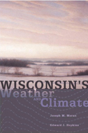
Now Available!
Wisconsin's Weather & Climate
by Joseph M. Moran &
Edward J. Hopkins
from
UW Press
Notes:
http://www.wisc.edu/wisconsinpress/books/3082.htm

Slide 3
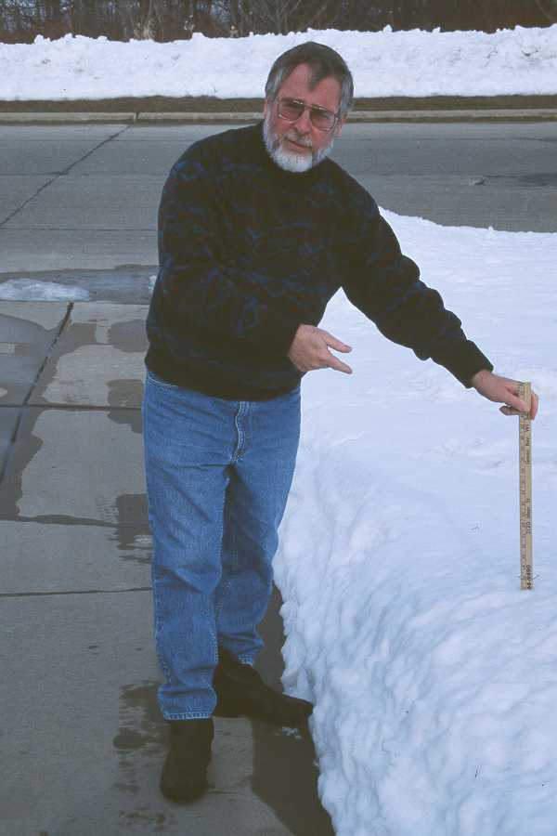
Who is that?
JOE MORAN

Slide 4

Reid A. Bryson
“To our mentor, Reid A. Bryson, a critical observer
of Wisconsin weather and climate for more than 50 years,
as well as a global pioneer in the study of climate variability
and its impacts on humanity.”

Slide 5
Background
Objective
  description of state’s weather & climate
Approach
  Scientific
  Historical
  Educational
Aim
  Readily accessible reference for broad audience
Notes:
http://www.wisc.edu/wisconsinpress/books/3082.htm

Slide 6
The Scope of the Book
Wisconsin - Land of Diversity
Disease, Shipwrecks & Crops
- Weather Observation before Technological Age
Balloons, Radar & Satellites
- Monitoring Weather/Climate in the Tech. Age
From Tropic Seas to Glaciers
- Wisconsin’s Variable Climate

Slide 7
The Scope of the Book (con’t.)
Wisconsin Winter - Cold & Snow
- Winter Storms & Cold Highs
- Winter Precipitation
    Snow
      Lake-Effect Snow
      Some Notable Snowstorms
    Sleet & Freezing Rain
- Winter Temperatures
    Frost Depth
    Lake Freeze Over
    Lowest Temperatures
    Hazards of Winter Cold

Slide 8
The Scope of the Book (con’t.)
Wisconsin Winter - Cold & Snow
Wisconsin Spring - Season of Rebirth
Wisconsin Summer - Lazy, Hazy Days
Wisconsin Autumn - From Indian Summer to Winter Gales
Climate Variability - Lessons of the Past & Prospects of the Future
Appendices - Information Sources &
Climate Data

Slide 9
Historical Background
First Humans - ca. 13,000 yrs. Ago
First modern European contact - Nicolet at Red Banks in 1634
British Influence 1760s to 1815
Northwest Territories 1787
Statehood 1848
Major Industries

Slide 10
Early Motivation for Weather Observations
To study possible link between climate & disease.
To obtain climate information in support of agriculture & commerce.
To gain better understanding of structure & movement of storm systems - i.e. , weather forecasting.

Slide 11
DID YOU KNOW THAT ...
1st Wisconsin weather observations made in 1820’s at
Ft. Howard, Ft. Winnebago & Ft. Crawford?
Dr. William Beaumont, who became famous for his pioneering research in human digestion, was also surgeon/weather observer at Forts Howard & Crawford?

Slide 12
U.S. Army Medical Department
Background
  The Nation’s first weather observing network.
  Purpose: Need for Weather Data
  to determine relationship between disease & climate in both settled areas and frontier
  Commenced at end of War of 1812

Slide 13
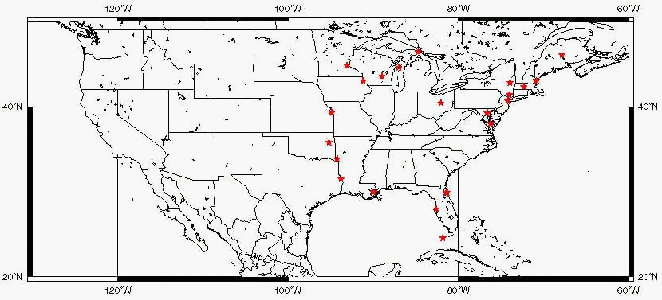
19th Century Forts Data ca. 1838
National Climatic Data Center

Slide 14
U.S. Medical Dept. & Wisconsin Forts (con’t.)
Significance of the network
  1842 S. Forry “The Climate of the United States and its Endemic Influences”
  1857 L. Blodget - “Climatology of the United States”
Forts in Wisconsin

Slide 15
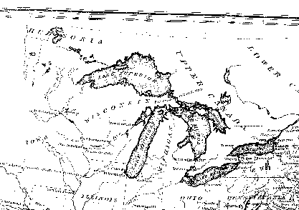
Forts in Old Northwest ca. 1840

Slide 16
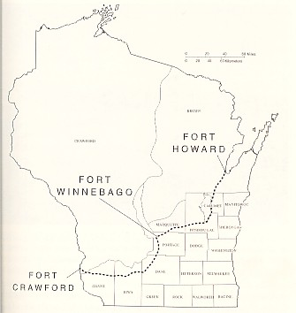
Wisconsin Forts
& the Military Road

Slide 17
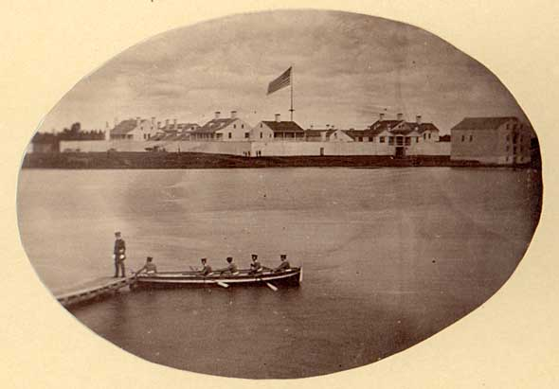
Ft. Howard
State Historical Society of Wisconsin: Negative No. WHi (x3) 23870

Slide 18
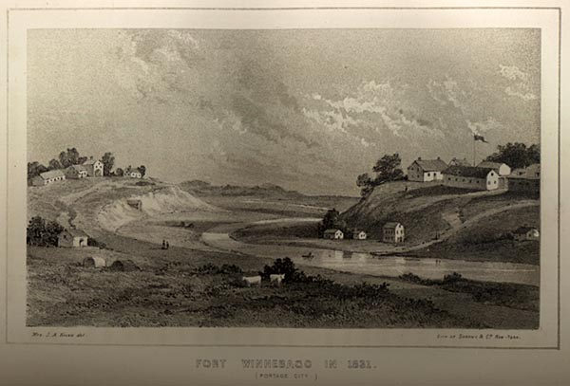
Ft. Winnebago in 1831
Kinzie, Mrs. John H. Wau-Bun, the "Early Day" in the Northwest. Chicago: D. B. Cooke & Co., Publishers, 1857.

Slide 19
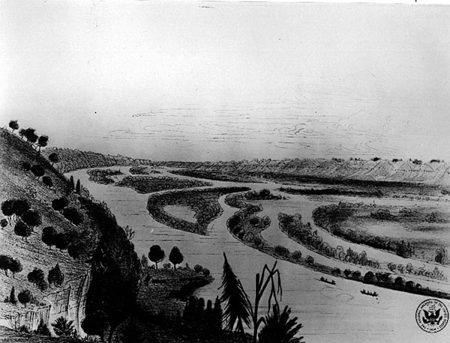
Mississippi River near Ft. Crawford 1837
State Historical Society of Wisconsin Visual Archives: Album 12.27

Slide 20
The Forts Weather Data
Observations (3 to 4 times daily)
  Starting in 1822:
  Temperature, prevailing winds & weather;
  Starting in 1837: precipitation;
  Starting in 1843: barometric pressure &
  wet bulb temperature.
Daily weather log and standard journal
Quarterly summaries
Complied National Data

Slide 21
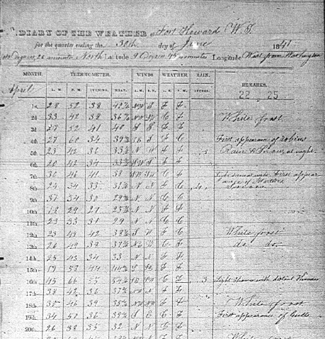
Daily Diary Ft. Howard June 1841

Slide 22
DURATION of WEATHER RECORDS at Wisconsin Forts
Temperature Record in red
Precipitation record in green

Slide 23
DID YOU KNOW THAT ...
First weather map was drawn by H. Brandes in 1819 of a storm in 1783?
First commercial electric telegraph line was opened in 1845 between Washington, DC & Baltimore, MD?
A major “Storm Controversy” developed in the early to mid-19th century?

Slide 24
Smithsonian Institution
Background
  Volunteer observing network from 1850s to 1870s.
  Developed by Joseph Henry, 1st Secretary of the Smithsonian & expert in magnetism.
  An amalgamation of other local networks.
Purpose
  To understand structure & movement of storm systems.
  To gain knowledge of climate of North American continent (during Manifest Destiny).

Slide 25
Smithsonian Institution (con’t.)
Type of Data
  1st class observers
    temperature, humidity, barometric pressure, clouds, winds & remarks (3 times daily)
  2nd class observers
    temperature and precipitation (3 times daily)
  3rd class observers
    no instruments; visual observations only

Slide 26
Smithsonian Institution (con’t.)
Significance of the network
  For “weather studies” and climate
    “Contributions to Knowledge” Series:
      Tables of Rain and Snow in United States
      Tables, Distribution and Variation of Atmospheric Temperature
      Winds of the Globe
  For “weather service” due to telegraph
    Daily weather maps in Washington, DC. in 1850s by Henry and Espy
    Daily weather forecast first issued 1 May 1857

Slide 27
Smithsonian Institution (con’t.)
Epilogue
  Transferred to U.S. Army Signal Service Volunteer Network in 1874.
In Wisconsin
  At least 35 observers in state.
  Included
    I.A. Lapham, Milwaukee
    J. Sterling at UW in Madison
    S. Lathrop at Beloit College

Slide 28
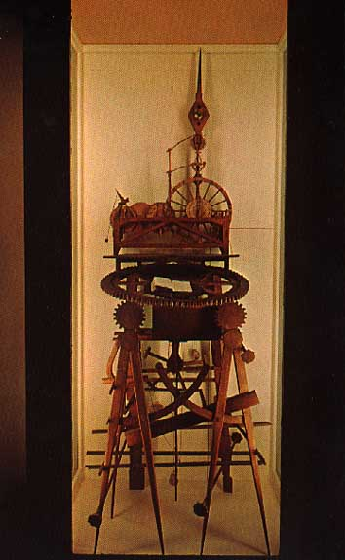
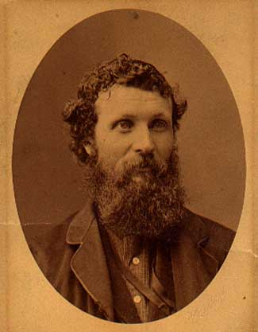
DID YOU KNOW THAT ...
John Muir (1838-1914) assisted Prof. J. Sterling with weather observations at the Univ.of Wisconsin in Madison during the1860s?

Slide 29
U.S. Army Topographical Engineers Lake Survey
Purpose
  A meteorological, topographic and hydrological survey of the “Northern and Northwestern Lakes”
History
  Headed by George G. Meade
  1858-1874
Data (three times daily)
  Water gauge height
  Barometric pressure
  Dry & wet bulb temperature
  evaporation & precipitation
  winds
  clouds

Slide 30
U.S. Army Topographical Engineers Lake Survey (con’t.)
Significance of the network
  Lake levels respond to prevailing winds.
  Instrumental for further development of a national weather service.
Where in Wisconsin & western Lakes
  Superior City
  Milwaukee (I.A. Lapham)
  also
  Ontonagon, Marquette, Grand Haven, MI & Michigan City, IN.

Slide 31
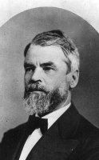
Increase A. Lapham 1811-1875

Slide 32
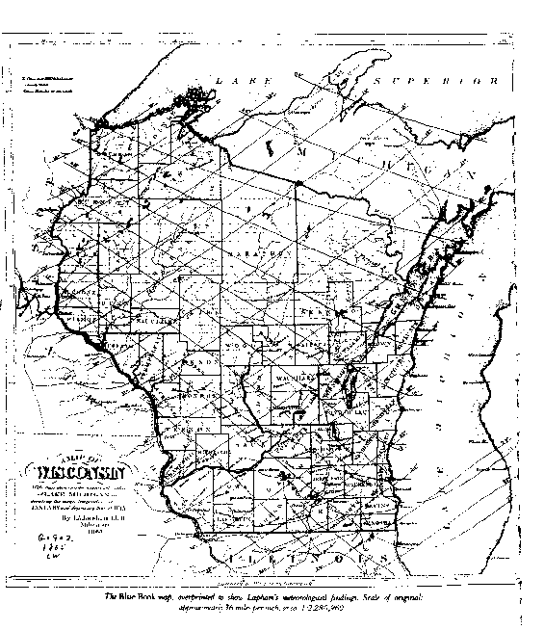
1865 Map by Increase Lapham
with warm & cold season isotherms
Notes:
Lap

Slide 33
U.S. Signal Service
Background
  Petition by I.A. Lapham of Milwaukee
  Creation of a military weather service in Feb 1870
  Assignment to the U.S. Army’s Signal Service as “The Division of Telegrams and Reports for the Benefit of Commerce (and Agriculture)”
Motivation
  Storm forecasts
The Network
  24 inaugural stations opened in Nov. 1870
  284 stations by 1878

Slide 34
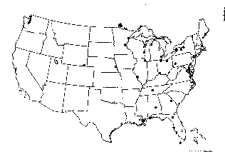
Inaugural Signal Service Stations 1 Nov.1870
Duluth
St. Paul
Milwaukee
Chicago

Slide 35
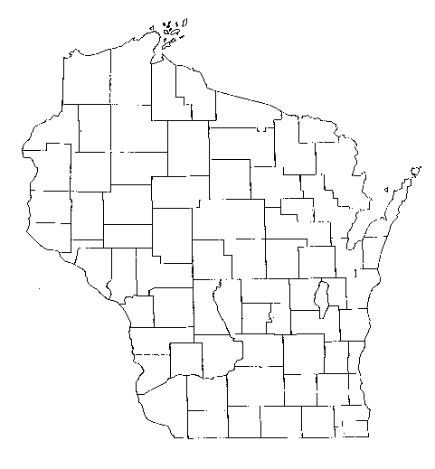
Signal Corps 1st Order Stations
Marquette 1871
Escanaba 1871
Green Bay 1886
La Crosse 1872
Madison 1878-83
Dubuque 1873

Slide 36
U.S. Signal Service- Stations
Facilities
  1st & 2nd order stations typically fully equipped and staffed; commanded by an “observer-sergeant”.
Observations & Reports
  Made 3 times daily
  Two sets of daily observations (for map analysis and for climatic purposes).

Slide 37
U.S. Signal Service (con’t.)
Significance of the network
  Emphasis on storm warnings and weather “probabilities”.
    1st weather map 1 Jan 1871
    1st daily weather forecast 19 Feb 1871
  Other Projects
    River and Flood Forecast Service (with stations at St. Paul, La Crosse, Dubuque, Wabasha)
    Frost and cold wave warnings
  Scientific research activities

Slide 38
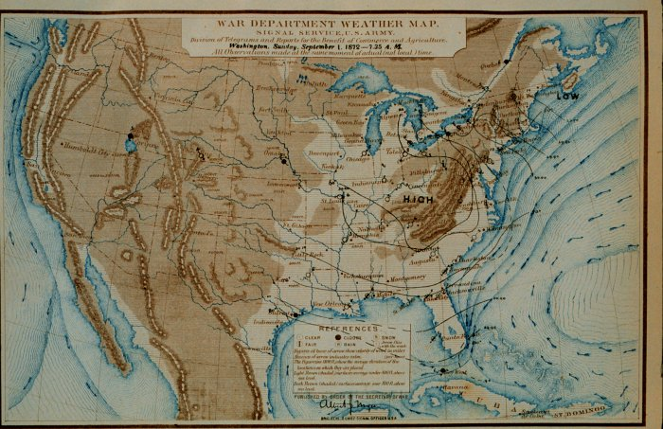

Slide 39
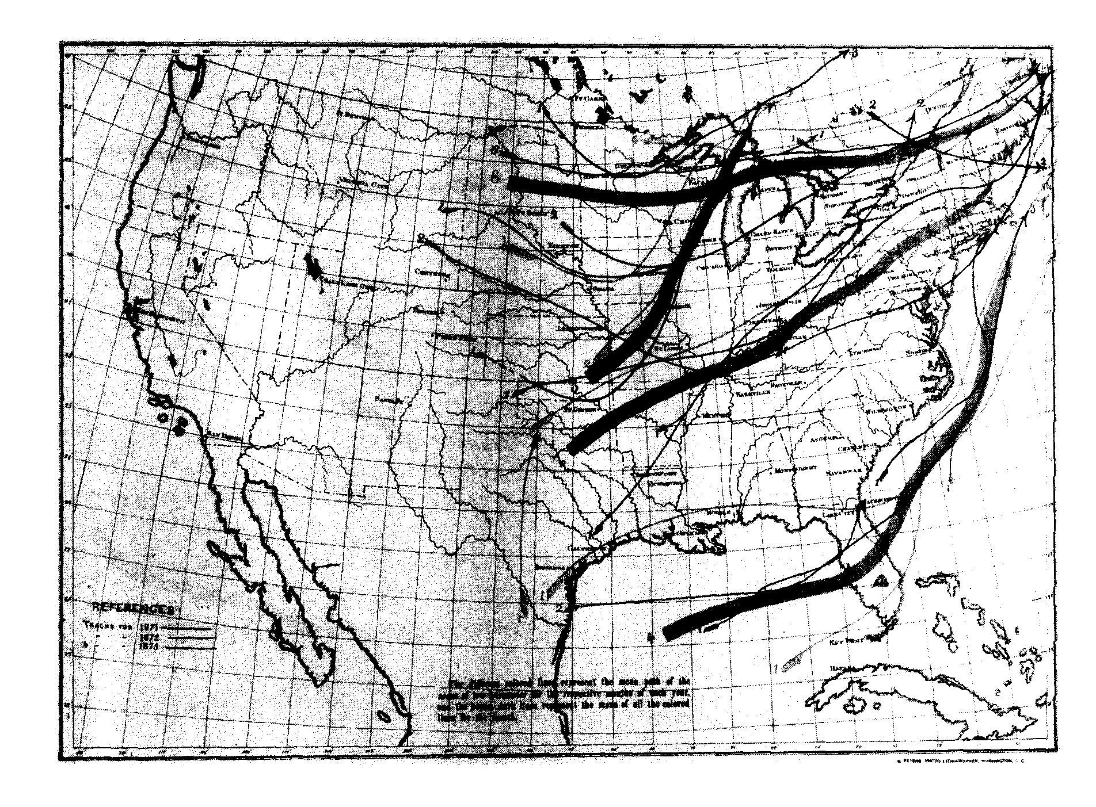
“Mean Tracks of Low Barometer for Dec. 1871,’72,’73” From Signal Office Report

Slide 40
DID YOU KNOW THAT ...
I.A. Lapham issued 1st storm-warning bulletin for Lake Michigan on 8 Nov. 1870, his 1st duty day as Assistant to the Chief Signal Officer?
Early public forecasts were displayed at Post Offices & railroad stations, then later (1895) sent by post card?
Eric Miller of U.S. Weather Bureau at North Hall made first public weather broadcasts on WHA in 1921?

Slide 41
U.S. Signal Service (con’t.)
Voluntary Observer Network
  Increased role in 1880s.
  Continuation of Smithsonian Network
  By 1890, 147 stations with 30 years of record.
  Collection of data from other networks
    Volunteers
    Post Surgeons
    State weather services

Slide 42
DID YOU KNOW THAT ...
Beloit College has one of the longest running instrument records in the state -- starting in 1849?
The Lups family (Jacob, Johana and Clarissa) of Manitowoc were cooperative weather observers, maintaining a nearly continuous daily weather record from 1851 to 1933? And that this site is designated as a US Historical Climate Network station?

Slide 43
U.S. Weather Bureau
Transfer to civilian agency as part of the Organic Act of 1890.
1891-1970
Shift from agriculture to aviation
Stations in Wisconsin
Cooperative Observer Network
  included
    Wisconsin Valley Improvement Co. (20 stations)
    UW. Experimental Farms

Slide 44
Weather Observing Stations 1890

Slide 45
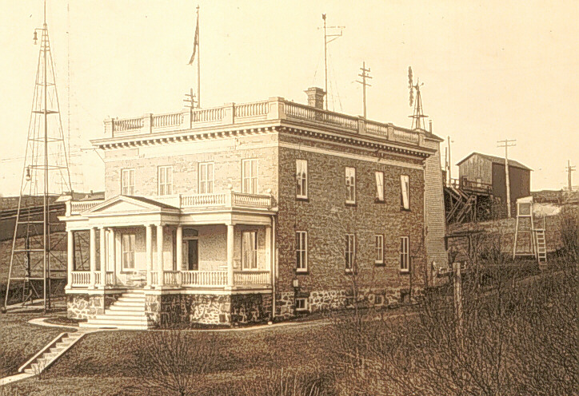
U.S. Weather Bureau Office at Duluth, MN ca. 1904
From Duluth Office History
Notes:
http://www.crh.noaa.gov/dlh/1904off.jpg

Slide 46
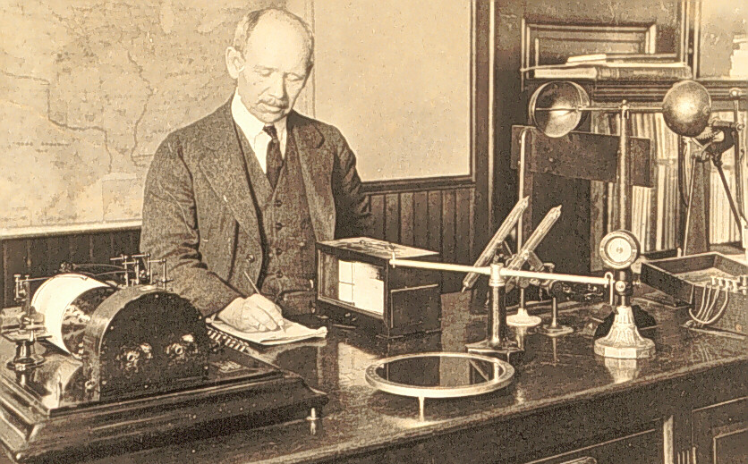
Inside an Early USWB Office
From Duluth Office History
Notes:
http://www.crh.noaa.gov/dlh/h_w_rich.jpg

Slide 47
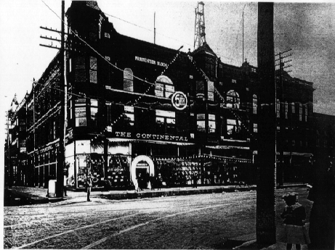
Green Bay USWB Office (1891-1910)

Slide 48
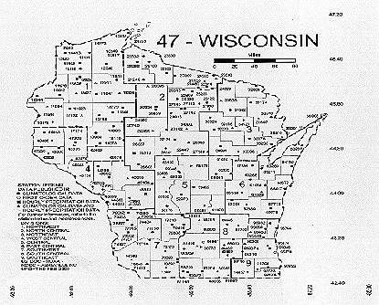

Slide 49
DID YOU KNOW THAT ...
The USWB made frost forecasts for Wisconsin cranberry bogs for nearly a century?
The Teletype replaced the telegraph in the 1920s and the facsimile machine was introduced in the late 1940s?

Slide 50
National Weather Service
1970-present
Modernization
  Doppler Radar
  ASOS
  AWIPS
  Satellites
Wisconsin

Slide 51
WSR-8D Radars &
NWS Forecast Offices 2000

Slide 52
WEATHER RADAR
History
  Post WWII (WSR 57 & WSR 74)
  Early National Network & Local Network
    Neenah
    Madison
Current Network
  NEXRAD to WSR-88D
    Green Bay, Milwaukee/Sullivan, La Crosse, Duluth, Marquette, Twin Cities, Quad Cities & Chicago

Slide 53
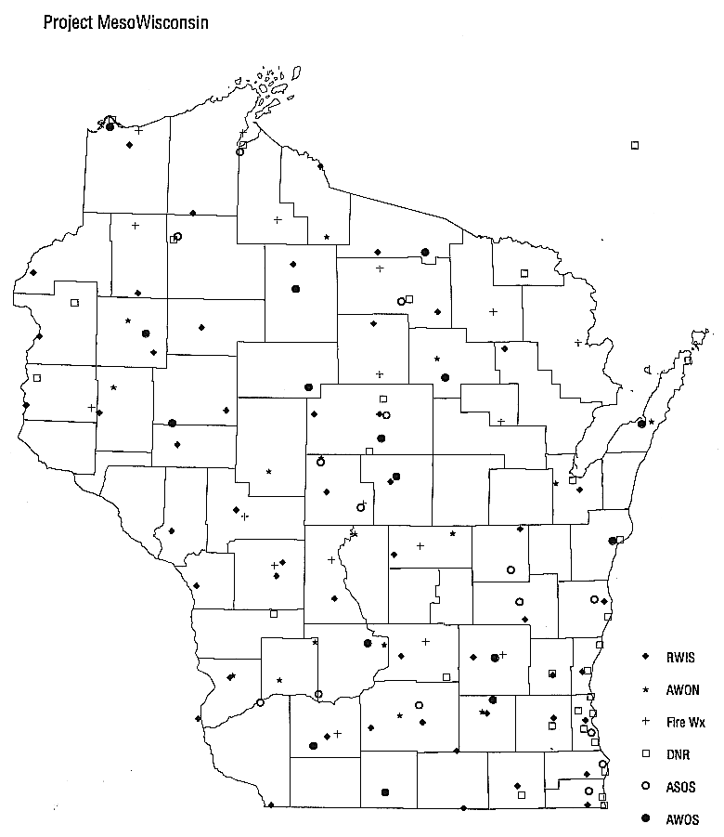
Automatic Weather Stations
NWSFO, MKX
Notes:
http://www.crh.noaa.gov/mkx/mesowi/images/meso.gif

Slide 54
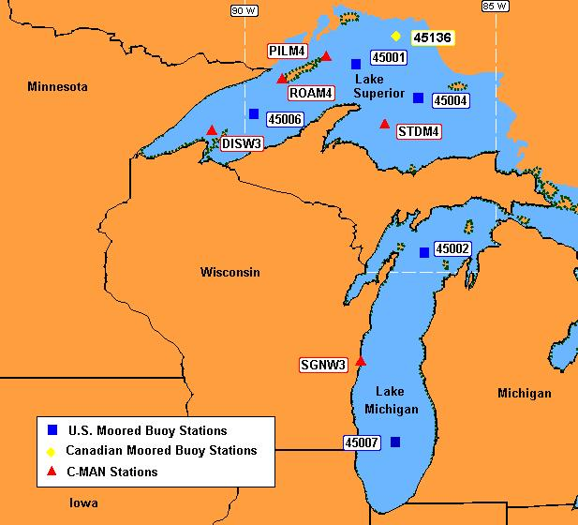
Moored Buoys and C-MAN Stations
National Data Buoy Center
Notes:
http://www.ndbc.noaa.gov/Maps/WestGL.shtml

Slide 55
Upper Air Program
Kites
  1898 - A 16 station experimental Kite Network to include Dubuque & Duluth.
Pilot Balloons
  1919? Madison
Aircraft
  1931 Chicago, Cleveland, Omaha & Dallas
Radiosondes
  1937 - 1st USWB launch in East Boston, MA.
  1945 at Green Bay

Slide 56
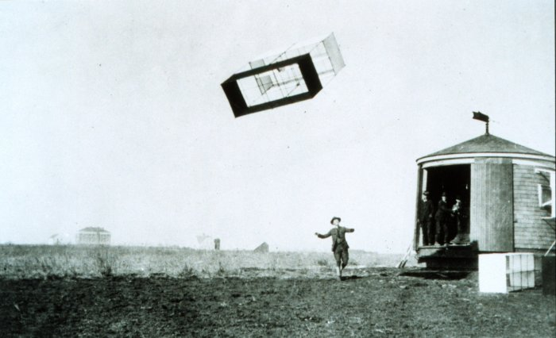
Weather Kites
Notes:
http://www.photolib.noaa.gov/historic/nws/wea01103.htm

Slide 57
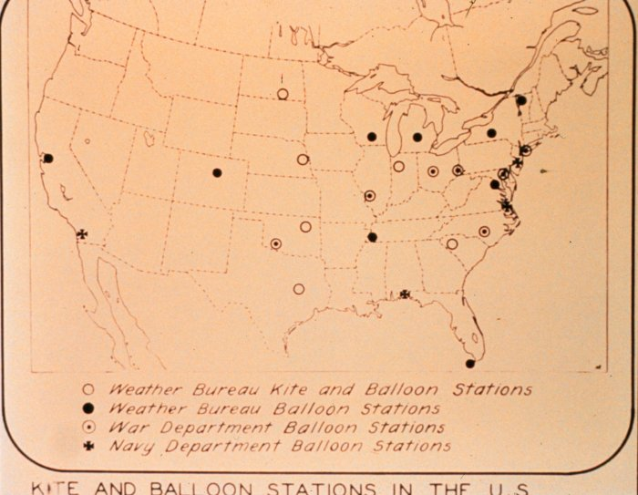
Kite and Balloon Stations ca. 1925

Slide 58
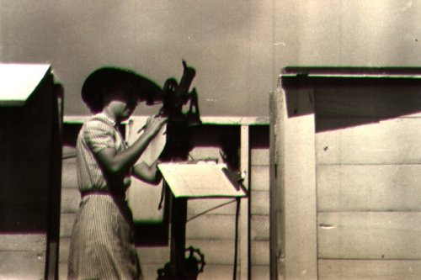
Weather Balloon Observations -- at Green Bay 1945

Slide 59
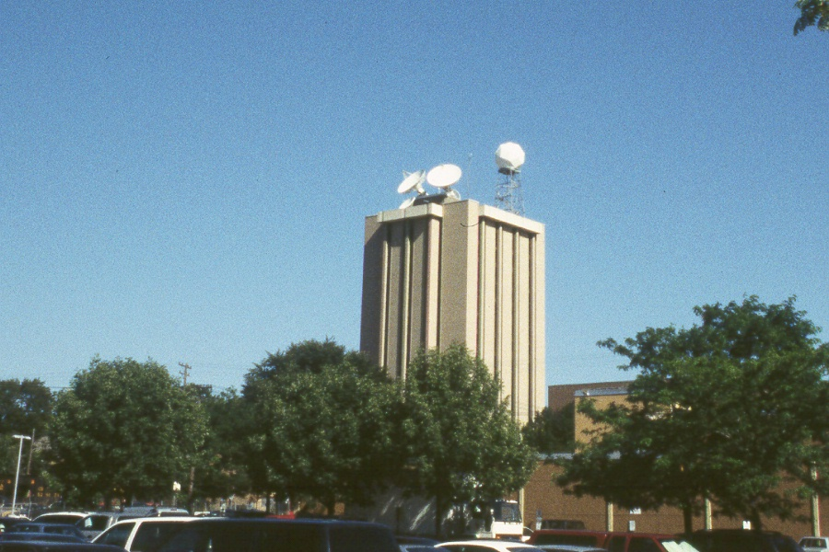
Weather Satellites and the Space Science & Engineering Center

Slide 60
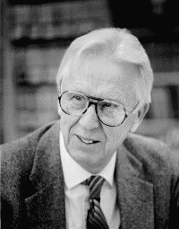
Vern Suomi (1915-1995)

Slide 61
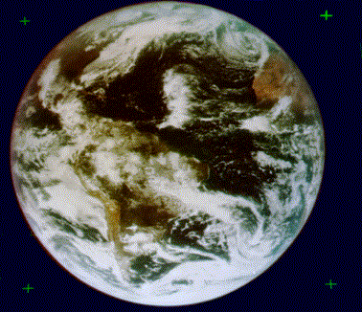
ATS-III in 1968

Slide 62
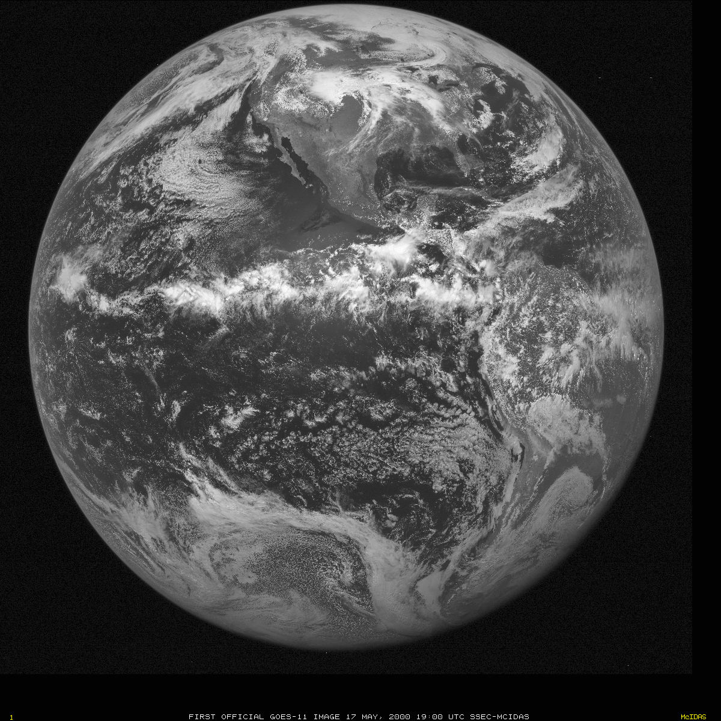
GOES-11 in 2000

Slide 63
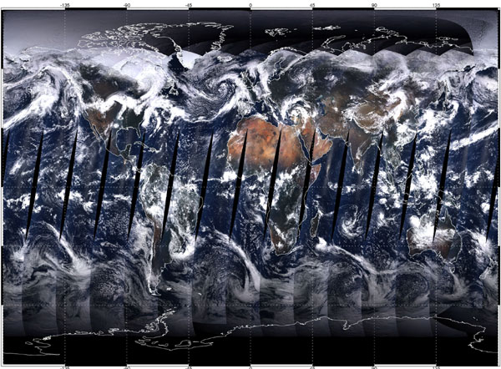
MODIS in 2000
(Moderate-resolution Imaging Spectroradiometer)
Notes:
MODIS Web Image#1000111 (Quick View Image)
First Complete Day from MODIS
This spectacular, full-color image of the Earth is a composite of the first full day
of data gathered by the Moderate-resolution Imaging Spectroradiometer
(MODIS) aboard NASA’s Terra spacecraft. MODIS collected the data for each
wavelength of red, green, and blue light as Terra passed over the daylit side of
the Earth on April 19, 2000. Terra is orbiting close enough to the Earth so that it
cannot quite see the entire surface in a day, resulting in the narrow gaps around
the equator. Although the sensor's visible channels were combined to form this
true-color picture, MODIS collects data in a total of 36 wavelengths, ranging
from visible to thermal infrared energy. Scientists use these data to measure
regional and global-scale changes in marine and land-based plant life, sea and
land surface temperatures, cloud properties, aerosols, fires, and land surface
properties.
Notice how cloudy the Earth is, and the large differences in brightness between
clouds, deserts, oceans, and forests. The Antarctic, surrounded by clockwise
swirls of cloud, is shrouded in darkness because the sun is north of the equator
at this time of year. The tropical forests of Africa, Southeast Asia, and South
America are shrouded by clouds. The bright Sahara and Arabian deserts stand
out clearly. Green vegetation is apparent in the southeast United States, the
Yucatan Peninsula, and Madagascar.
http://modis.gsfc.nasa.gov/MODIS/IMAGE_GALLERY/MODIS1000111_md.html

Slide 64
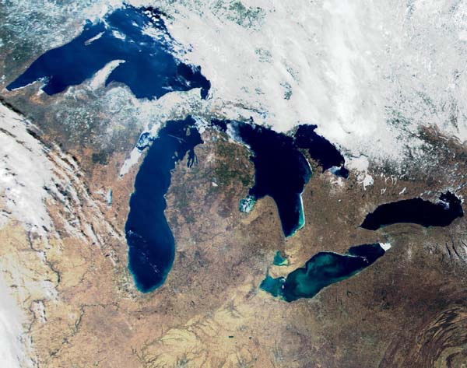
MODIS
Notes:
http://modis.gsfc.nasa.gov/MODIS/IMAGE_GALLERY/MODIS1000046_md.html
250 m resolution

Slide 65
Integrity of the Instrumental Climate Record -
The Premise
  Can we detect changes in Wisconsin’s climate?
The Record
  Weather records from mid 19th century

Slide 66
Issues
Instruments
  Accuracy
  Changes in Instrument types (response times)
  Indicating to self-recording
Instrument Exposure
  Elevation above surface
  Surface characteristics (roof vs. grass)

Slide 67
Issues (con’t.)
Site Locations
  Topography
  Proximity to lakes and/or urban areas
Observing Practices
  Time of day
  Averaging techniques

Slide 68
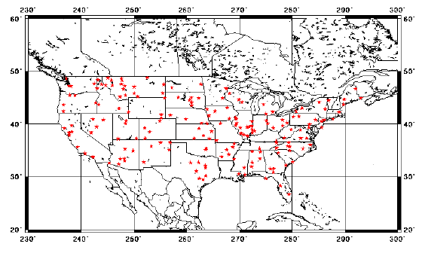
The Daily U.S. Historical Climatology Network
Notes:
http://www.ncdc.noaa.gov/ol/climate/research/ushcn/daily.html

Slide 69
http://www.wisc.edu/wisconsinpress/books/3082.htm
Notes:
http://www.wisc.edu/wisconsinpress/books/3082.htm

Slide 70
Contact
Ed Hopkins
Dept. of Atmospheric & Oceanic Sciences
UW-Madison
1225 W. Dayton
608/262-2828
hopkins@meteor.wisc.edu

